Slide 1
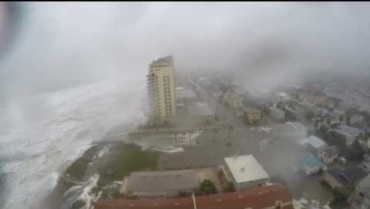
National differences in the NFIP

Slide 2

Background
Flood damage is excluded from standard homeowners and renters insurance.
Flood insurance is available through the National Flood Insurance Program (NFIP) administered by FEMA
Private coverage has only been available since 2019
Private companies often offer higher coverage ($500,000 vs $250,000)
Experts note that the current approach to flood risk is not sustainable.
People moving into flood prone regions, sea level rise, and extreme weather.

Slide 3
The Risk – Flooding
Flooding is the most costly and deadly disaster in the USA
In 2021, nearly 8 million coastal homes (East Coast only), representing $1.9 trillion in cost, are at risk of storm surge
E.g. in 2017, three major Hurricanes struck the US (Harvey, Irma, Maria)
More than 220,000 claims
10.3$ billion value
Climate change and continued development of flood-prone areas will enhance the losses, potentially by a factor of 20

Slide 4
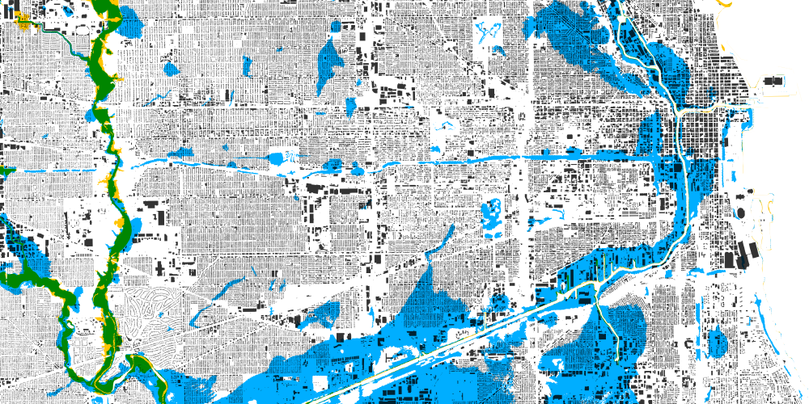
The Data – Policy and claims
Census data
FEMA.gov open data sets
Flood insurance policy and claims published originally in 2019
CLAIM DATA: 2,000,000 redacted claims!!
BUT the data portal is undergoing upgrades, and the dataset was not available
- Instead: a summary of the number of claims per state

Slide 5
The Data – Policy
Policy dataset
1
2
…
…
50,000,000
Variables: dates, state, floodzone, amount covered
Time period covered: 2009 – August 2019

Slide 6
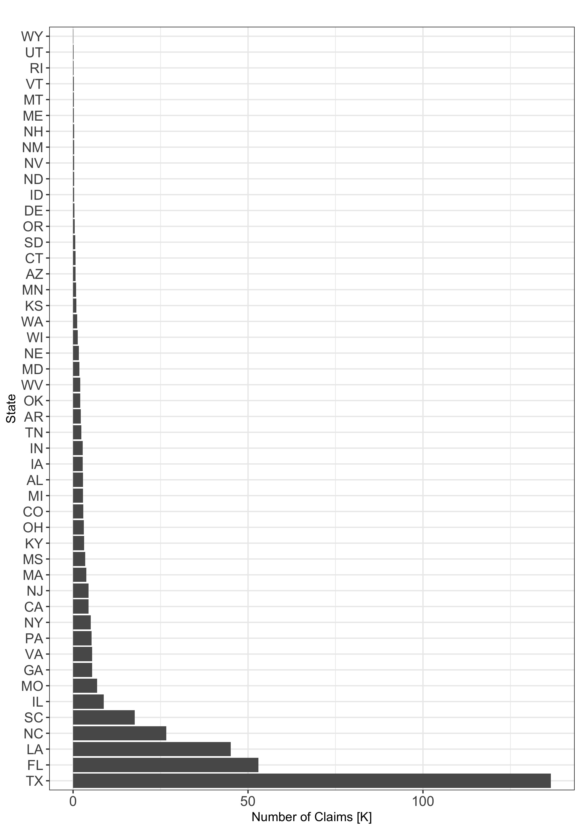
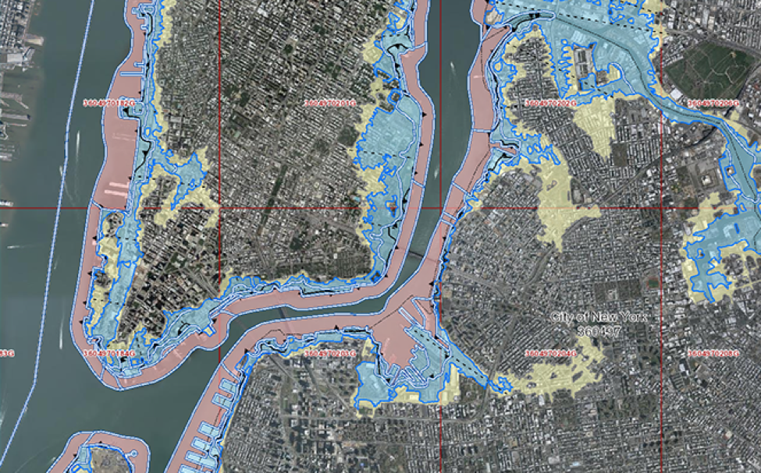
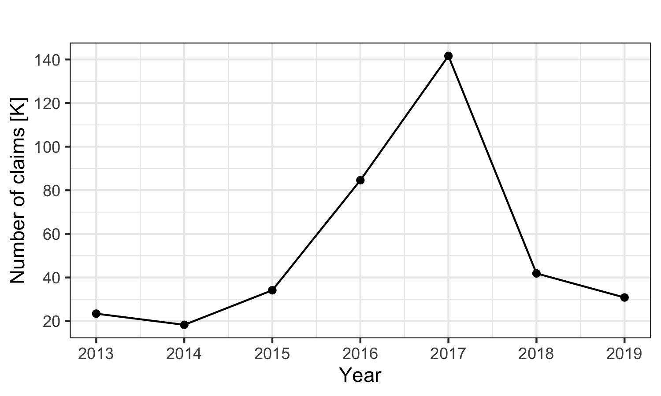
Number of claims 2013 - 2019

Slide 7
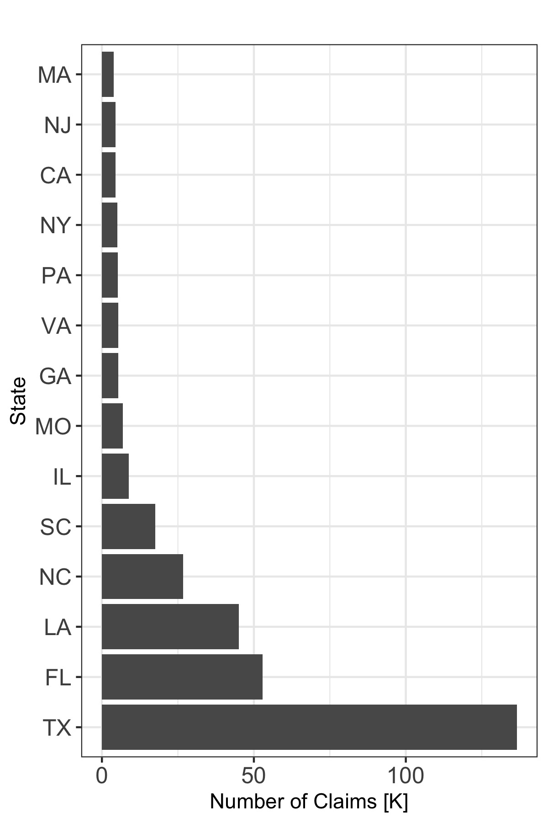
Number of claims 2013 - 2019
Texas had the largest number of total claims, followed by Florida and Louisiana

Slide 8
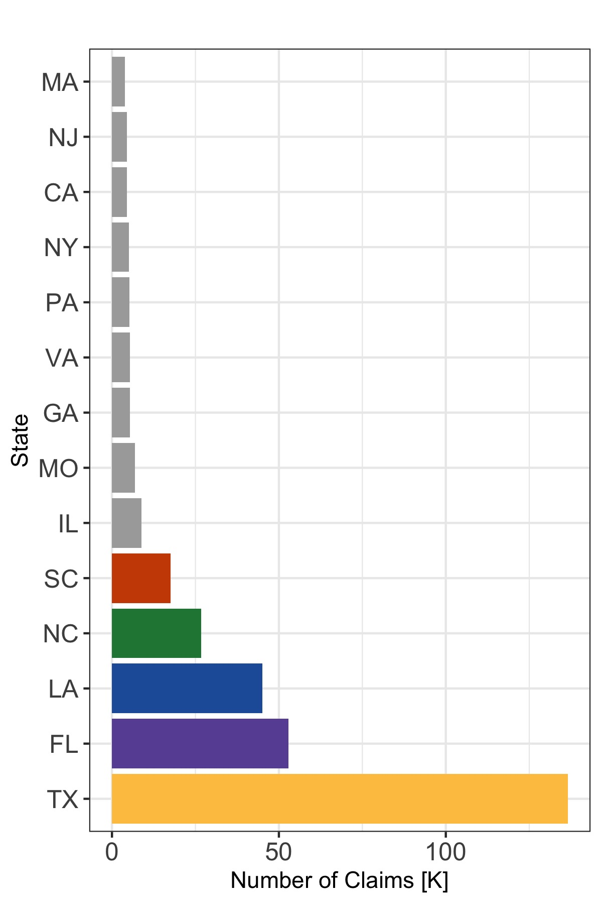
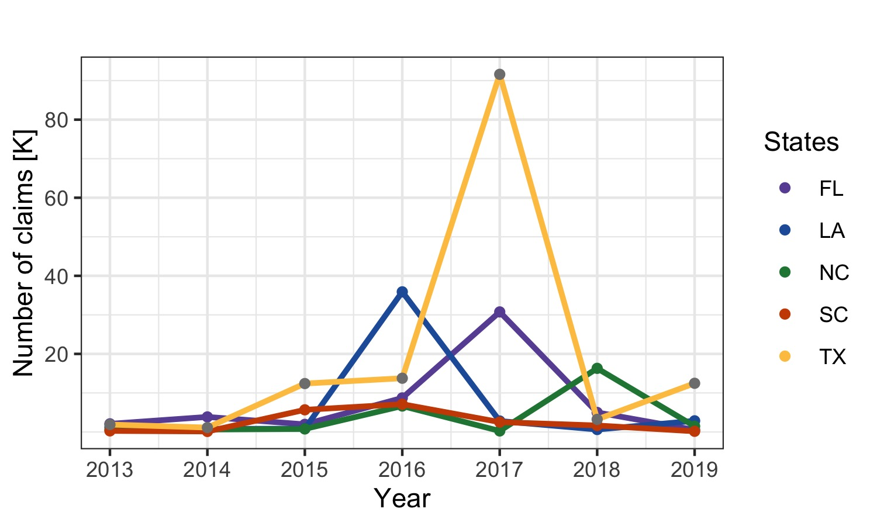
Number of claims 2013 - 2019
2016: Louisiana flooding
2017: Harvey (TX), Irma (FL)

Slide 9
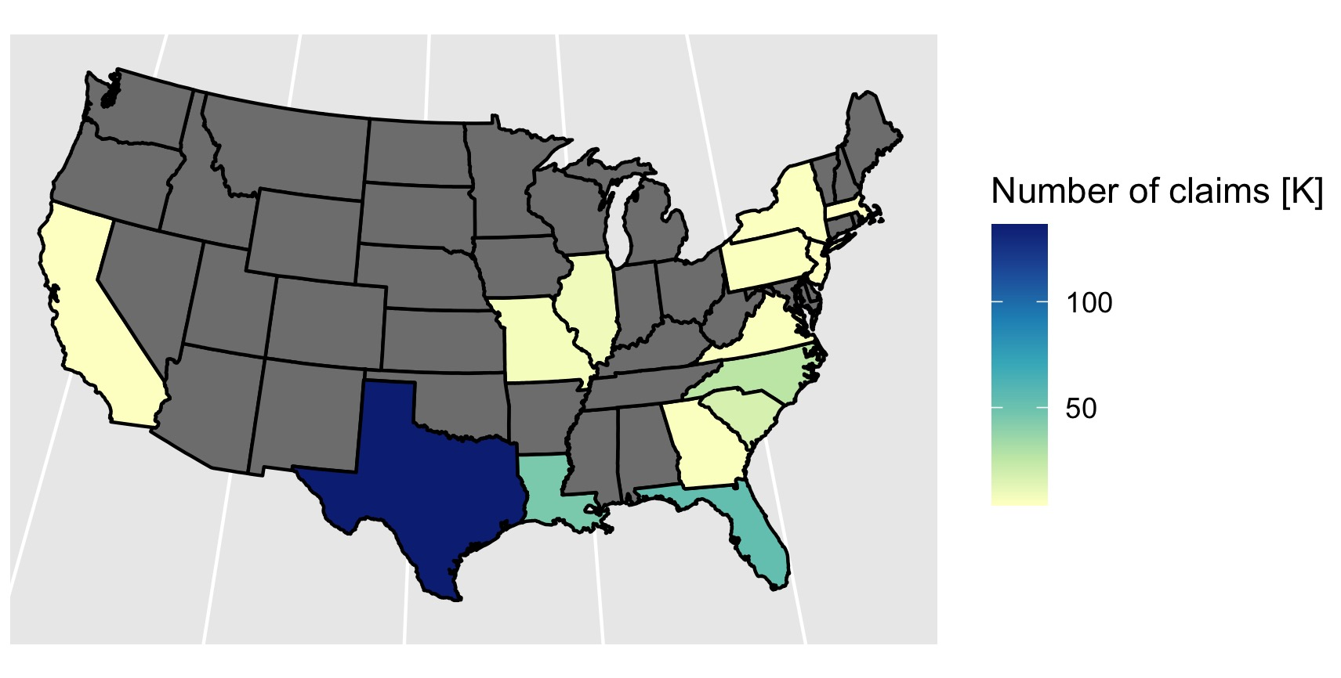
Number of claims 2013 - 2019

Slide 10
Average Cost – per Region

Slide 11
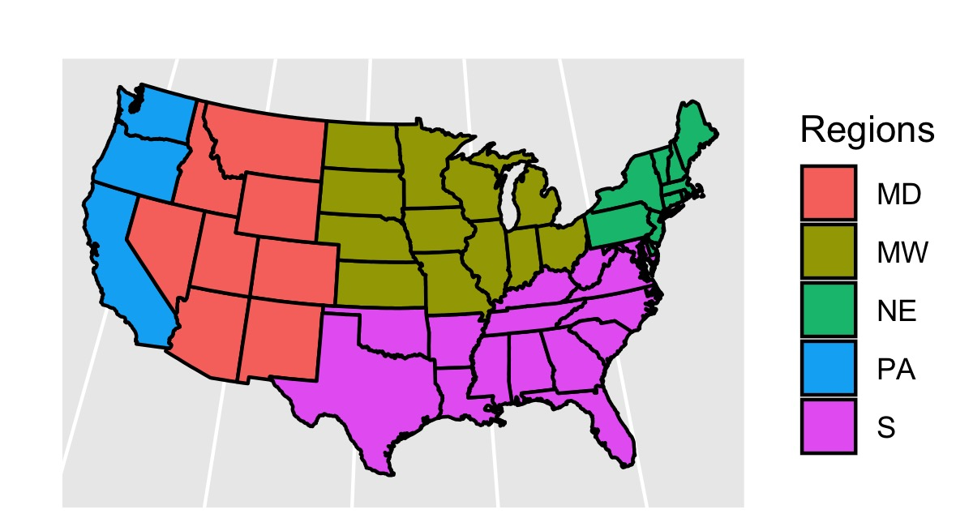
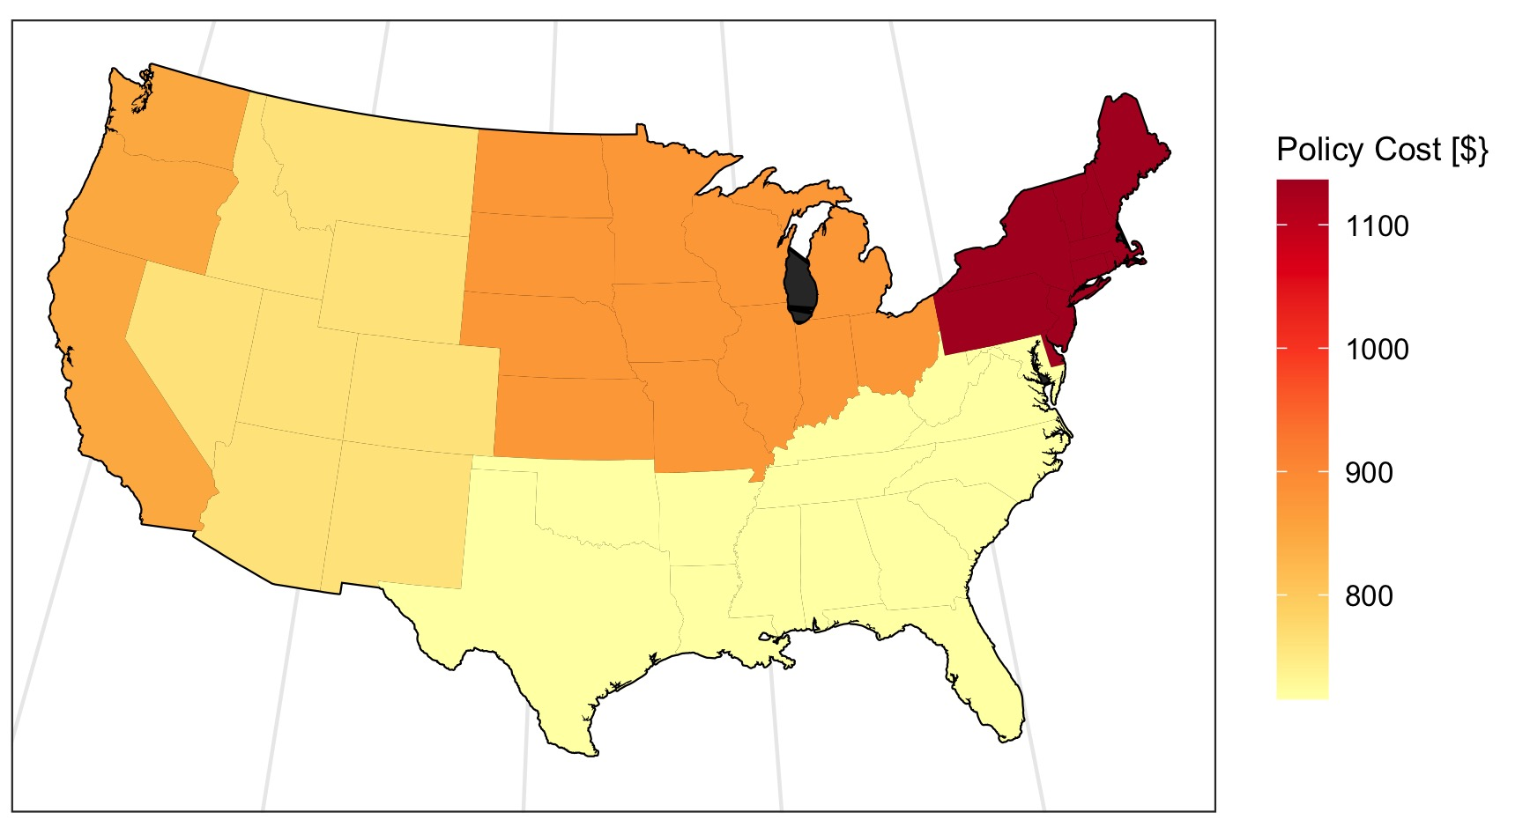
Average Cost – per Region
$850
$1140
The average cost of flood insurance is lowest in the south ($715) and most expensive in the northeast ($1140)
$876
$760
$715

Slide 12
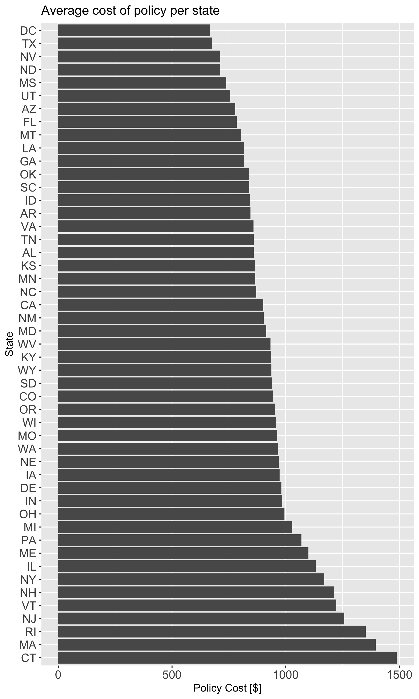
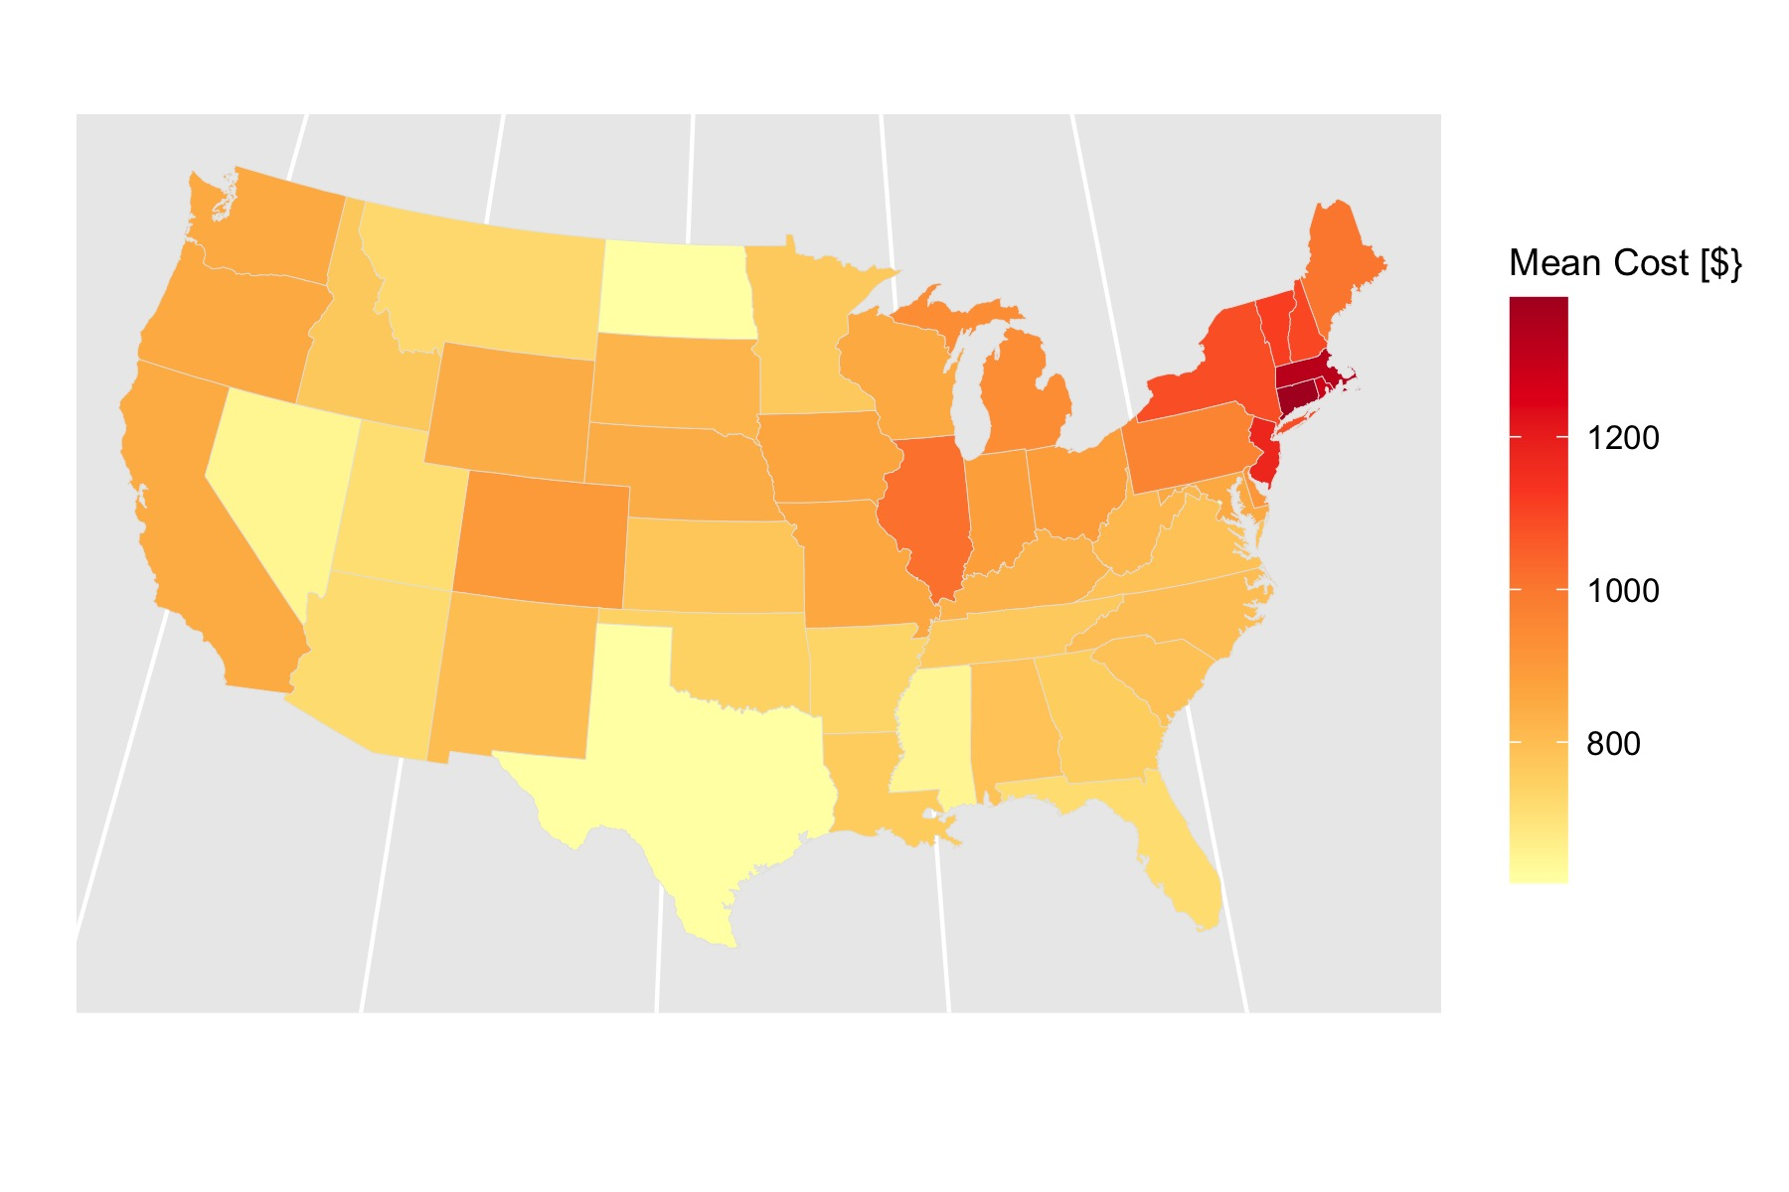
Average Cost – per State
Cheapest: TX, NV, ND ($720)
Most Expensive: CT, MA, RI (> $ 1300)

Slide 13
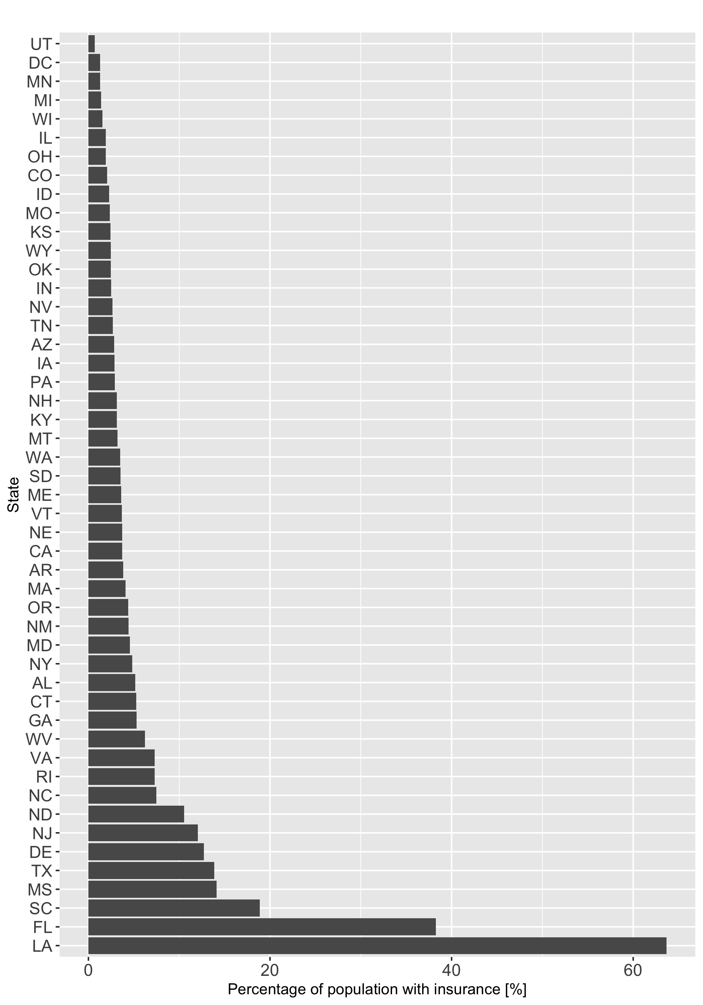
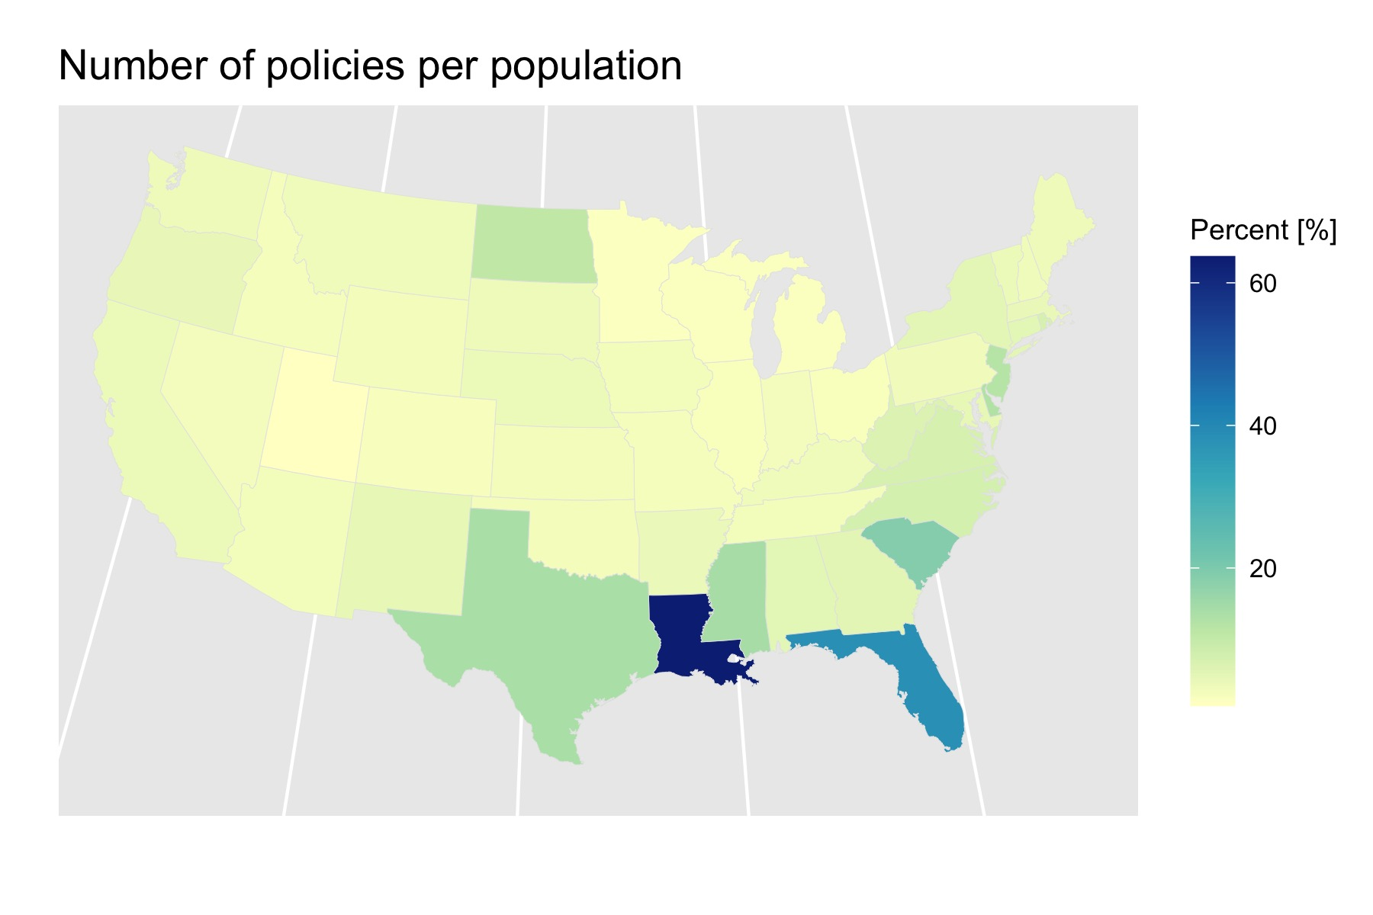
% of population with insurance
Clear standout: LA (> 60%)
But also: FL, SC, MS, TX

Slide 14
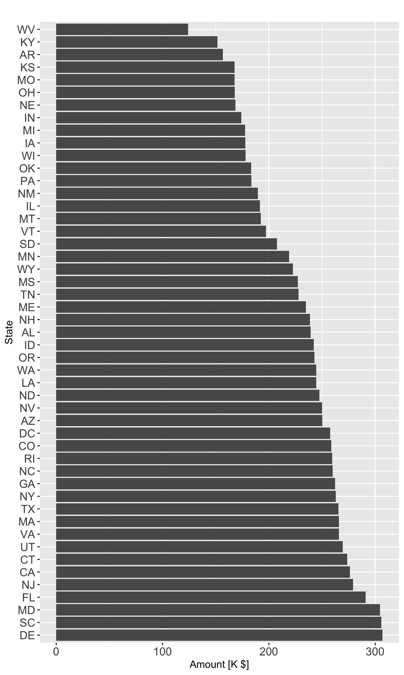
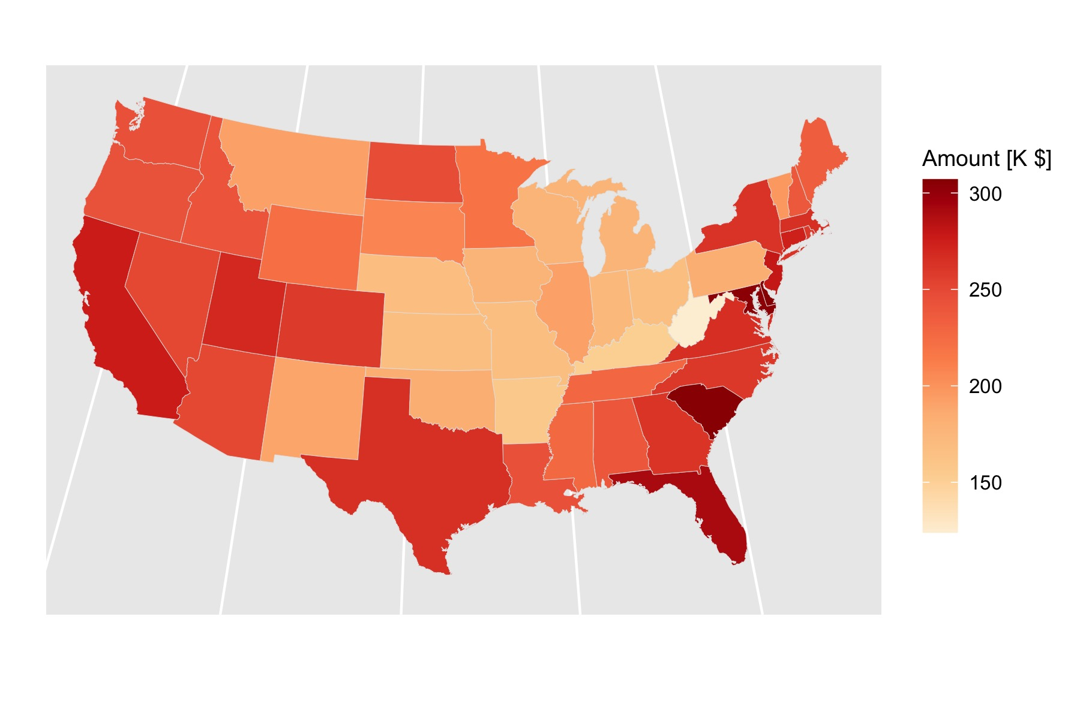
$$ Insured (building + content)
Clear standout: East coast
But also: Gulf Coast and CA

Slide 15
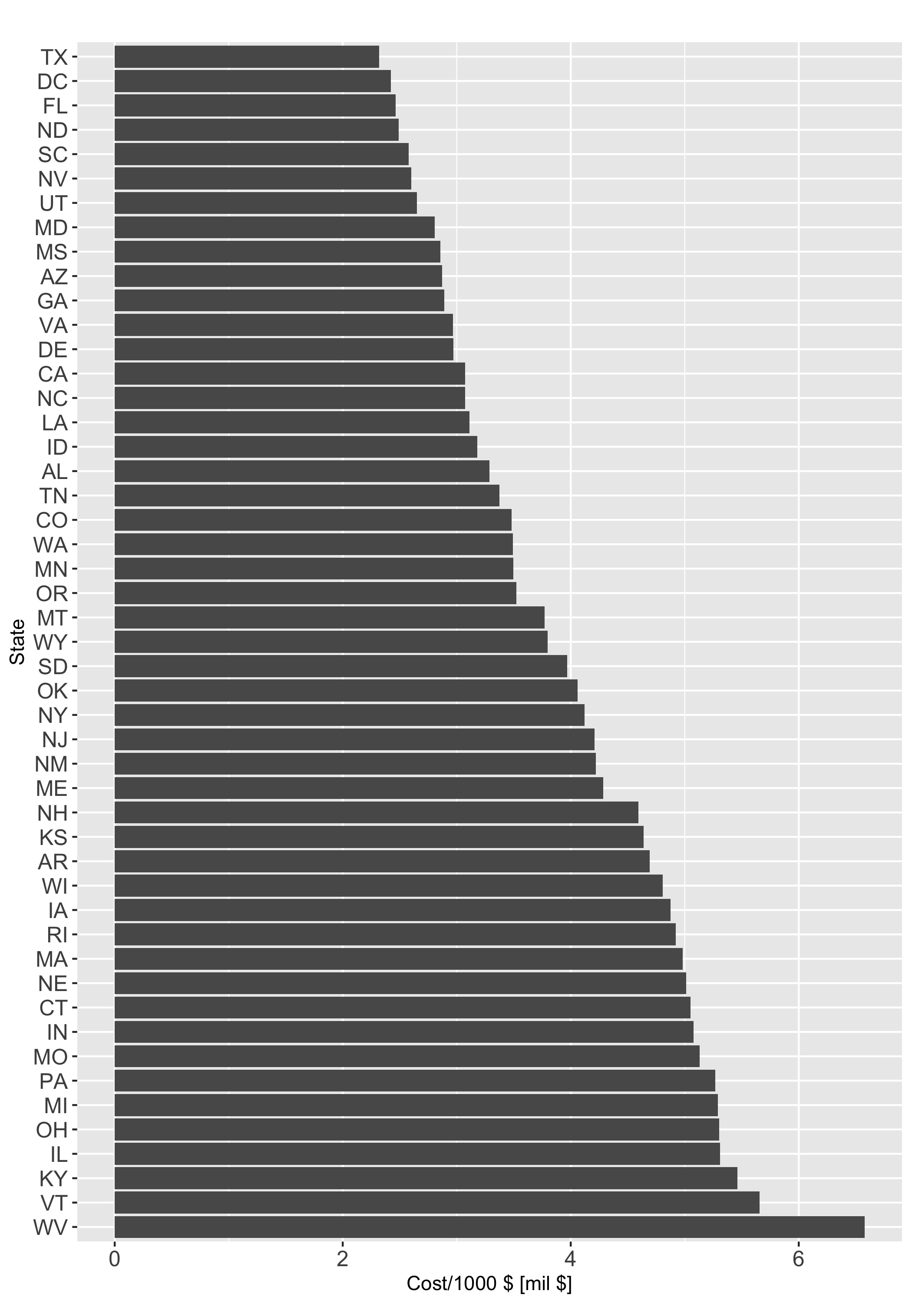
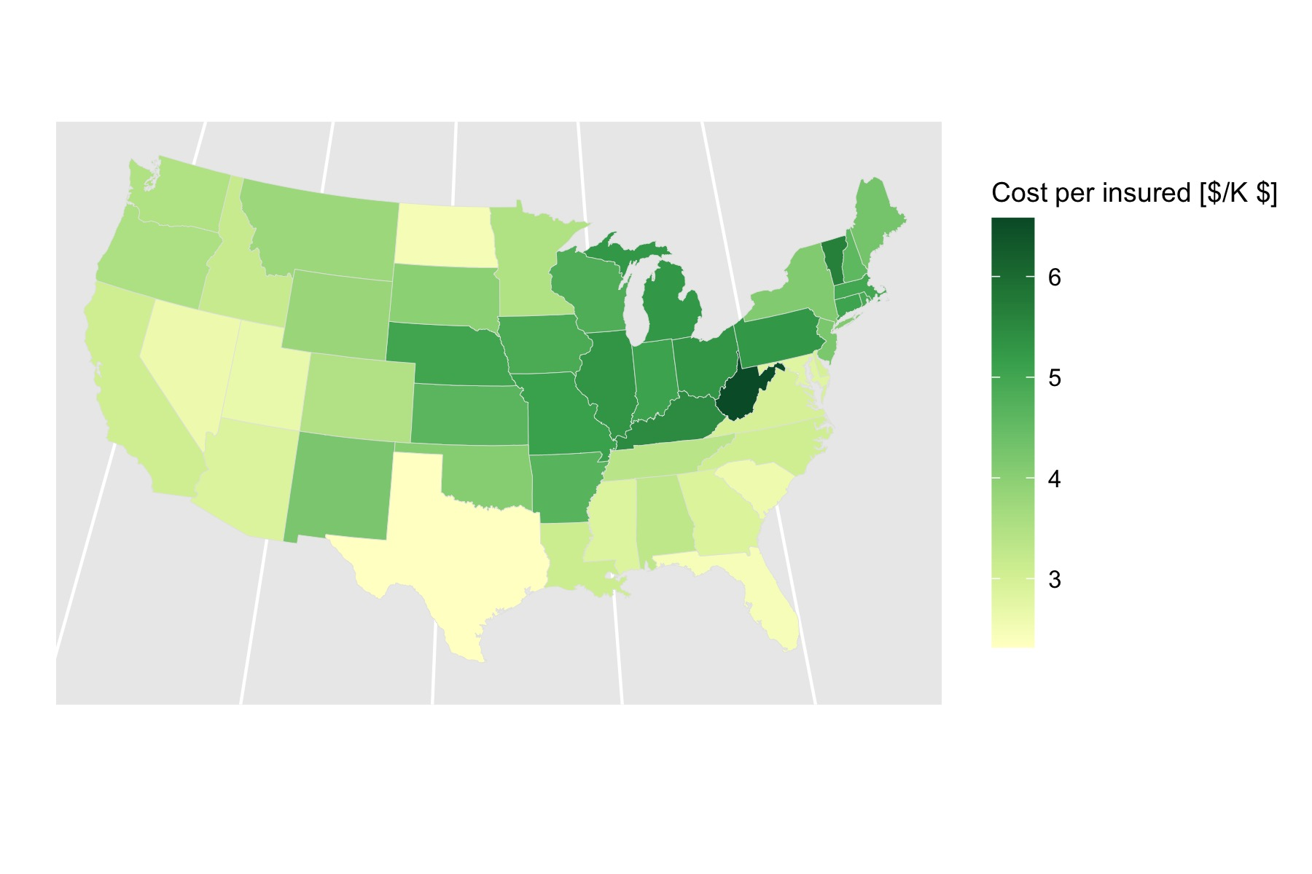
$/1000$ per insurance
Clear standout: West Virgina is the most expensive
But also: States away from the coast

Slide 16
Price for amount insured
Policies per population
Amount insured
Mean Cost

Slide 17
Changes over time

Slide 18
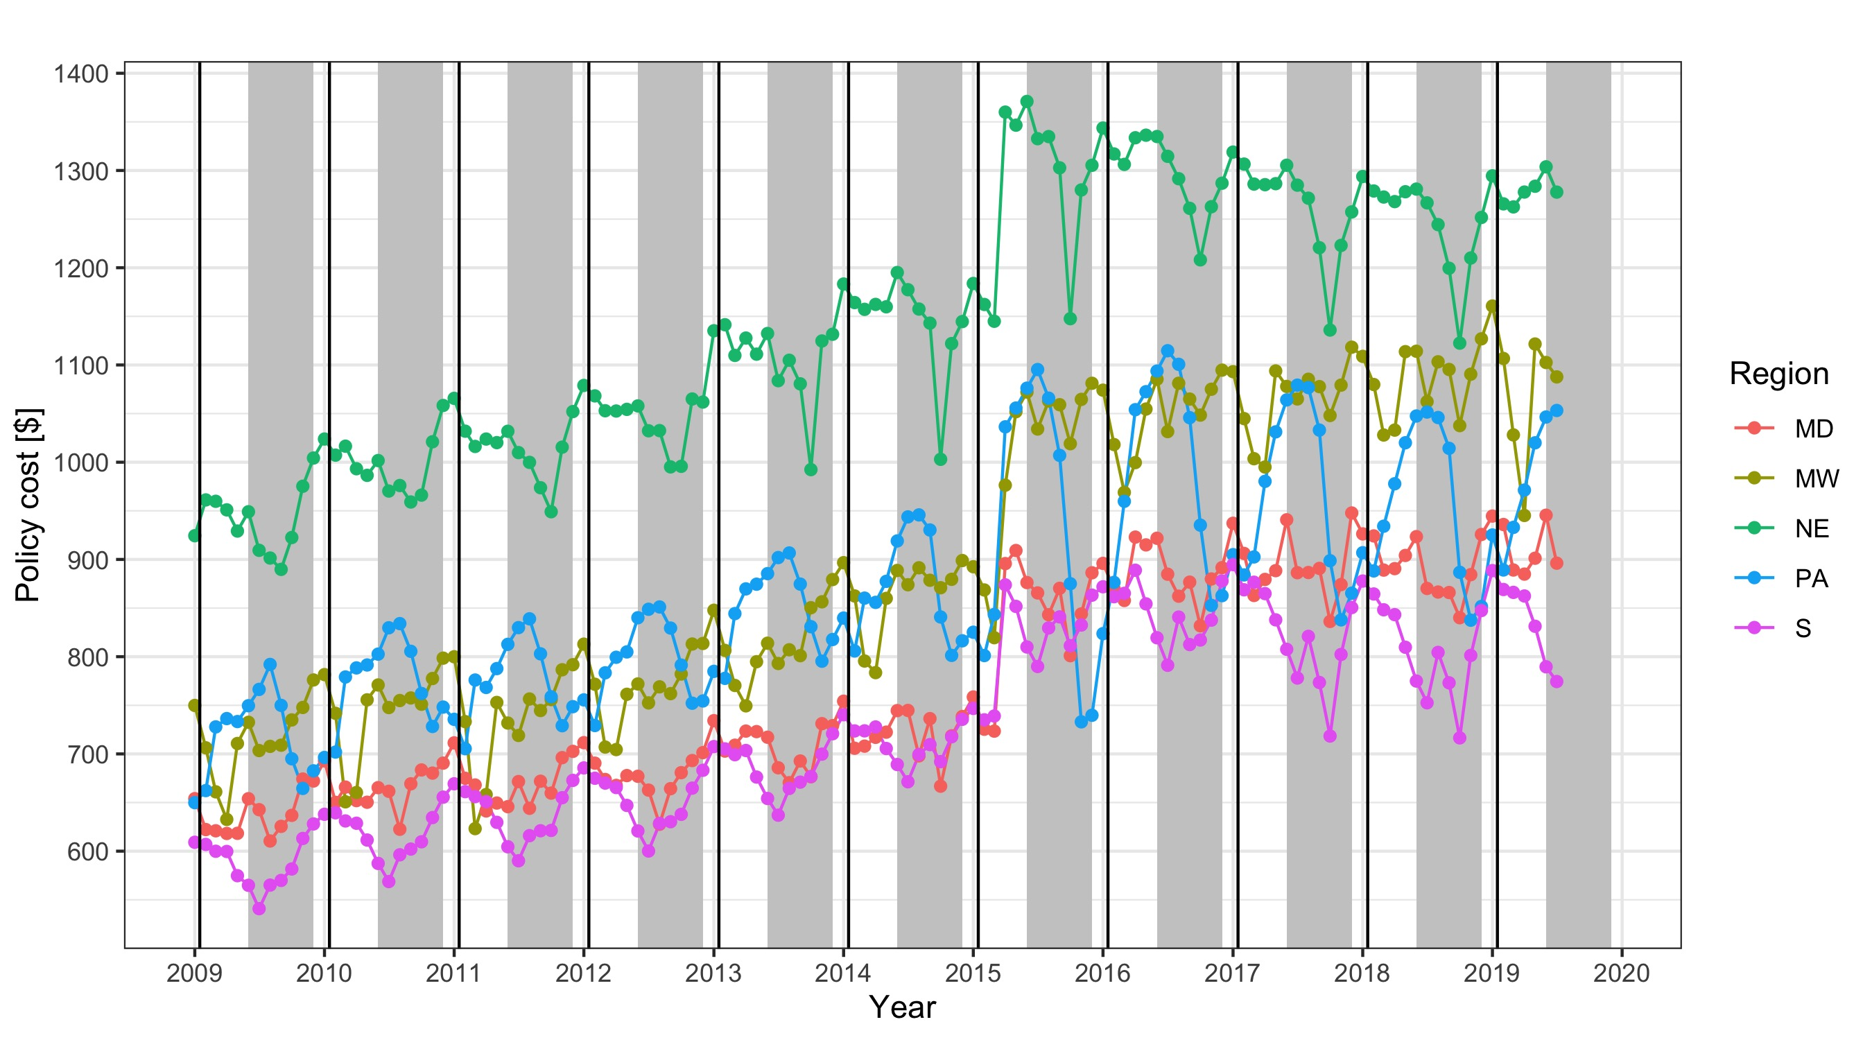
Strong seasonal cycle in all regions.
But also trend.
PA and S/NE are anti-correlated.
Remove seasonal cycle and analyze trend only.

Slide 19
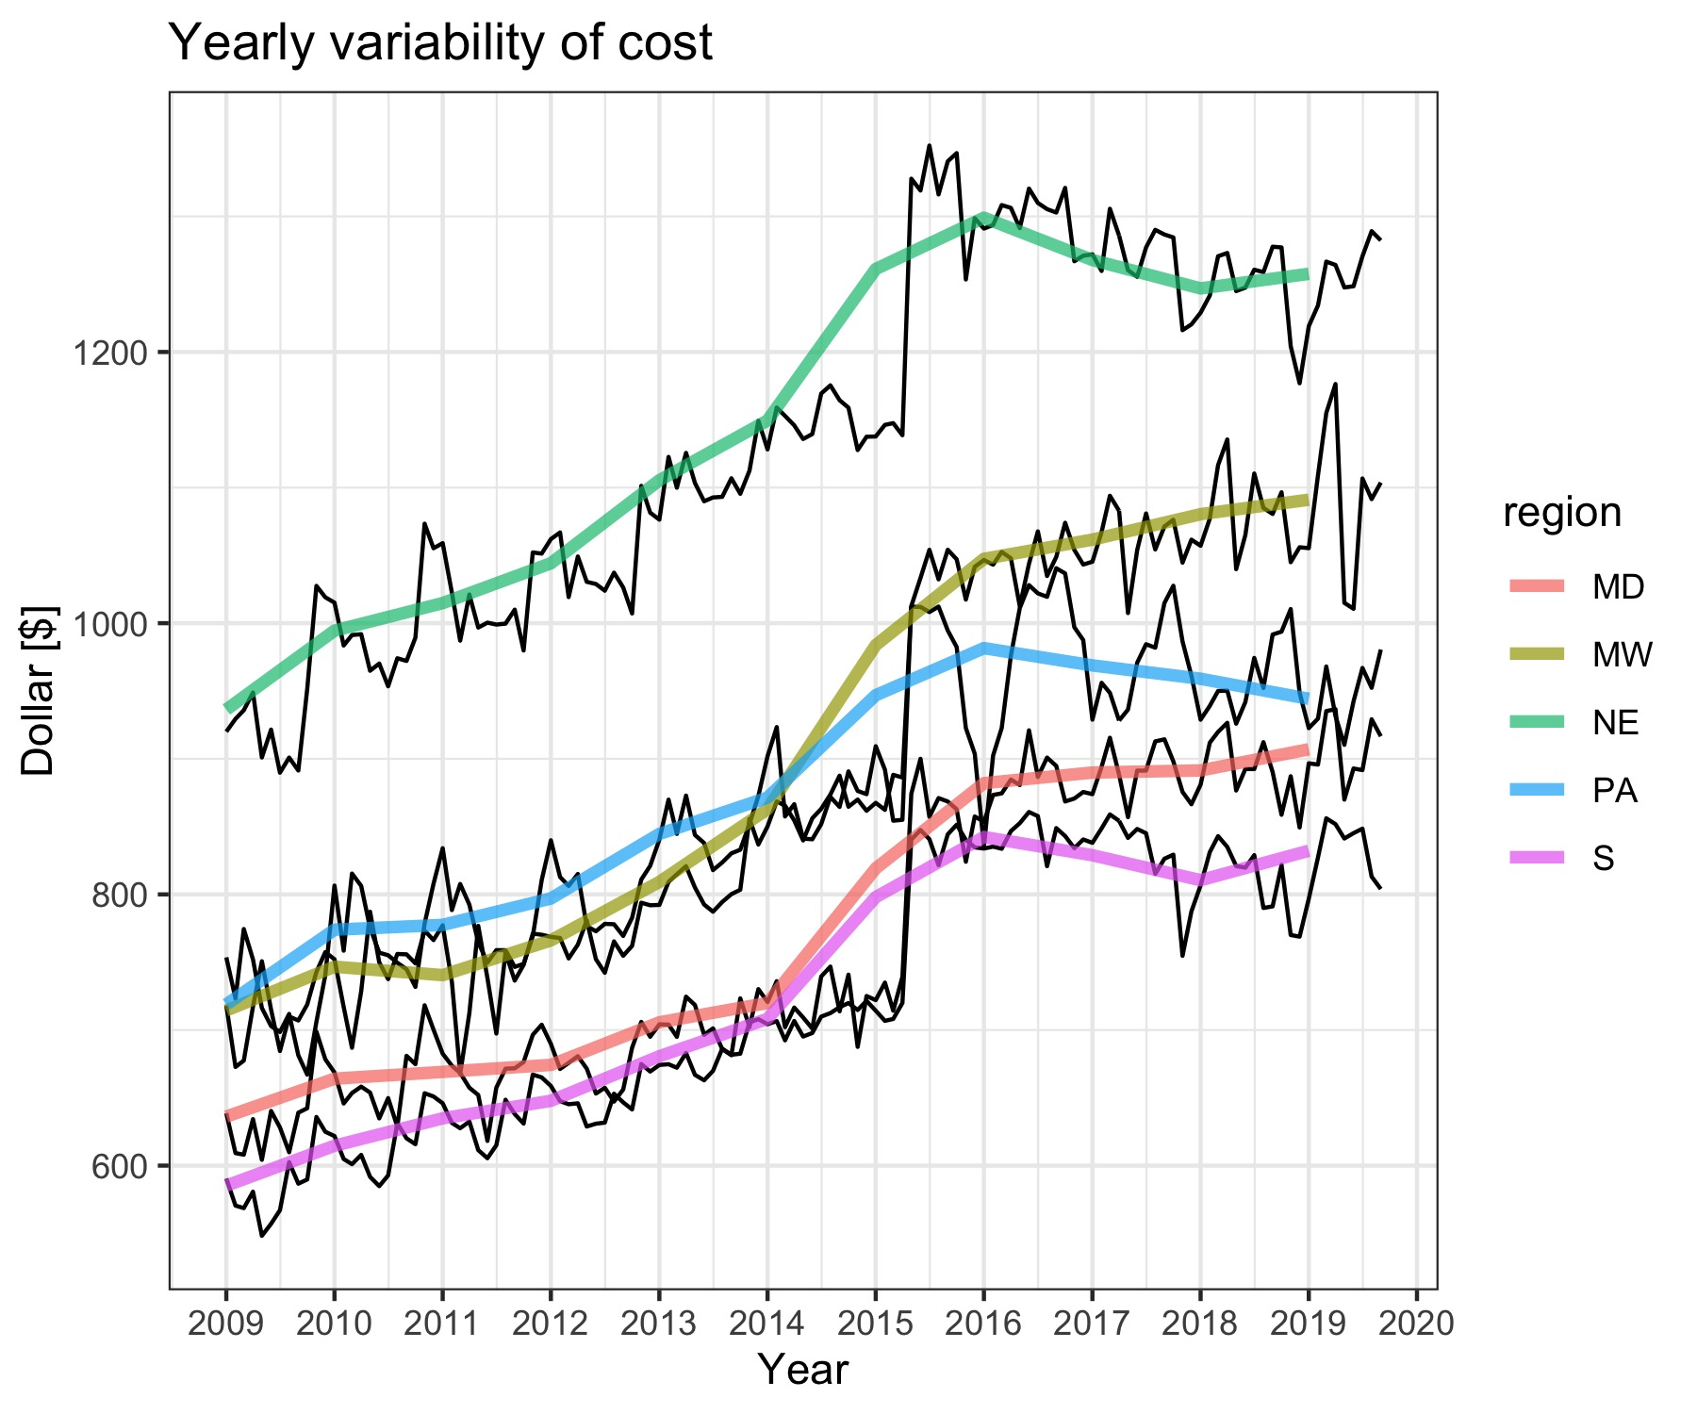
Annual variability of insurance cost
Black line: monthly cost
Colored line: Yearly trend
All regions show a general increase
Jump in 2015 → change in insurance policy
Fit line to calculate change in cost

Slide 20
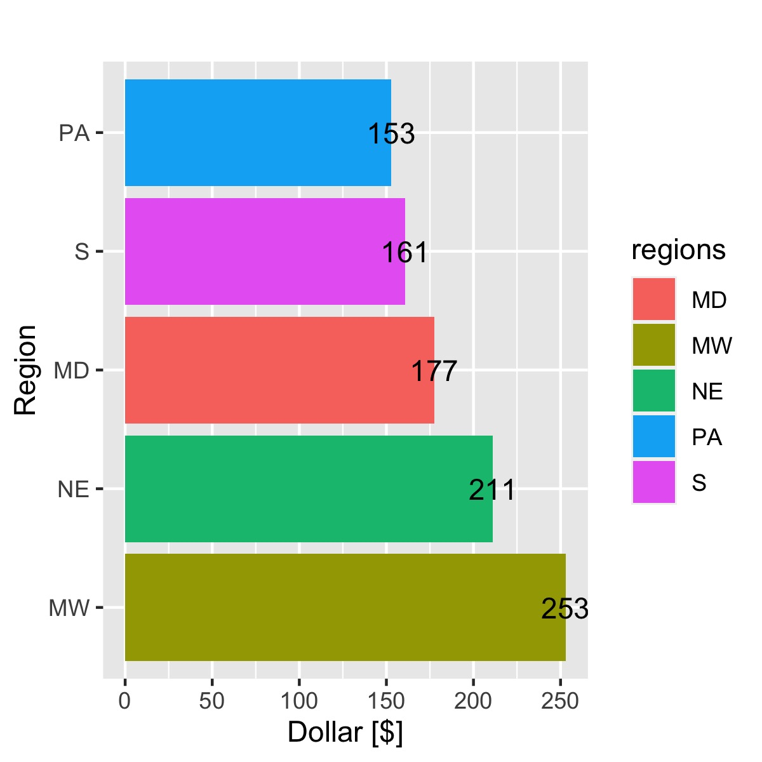
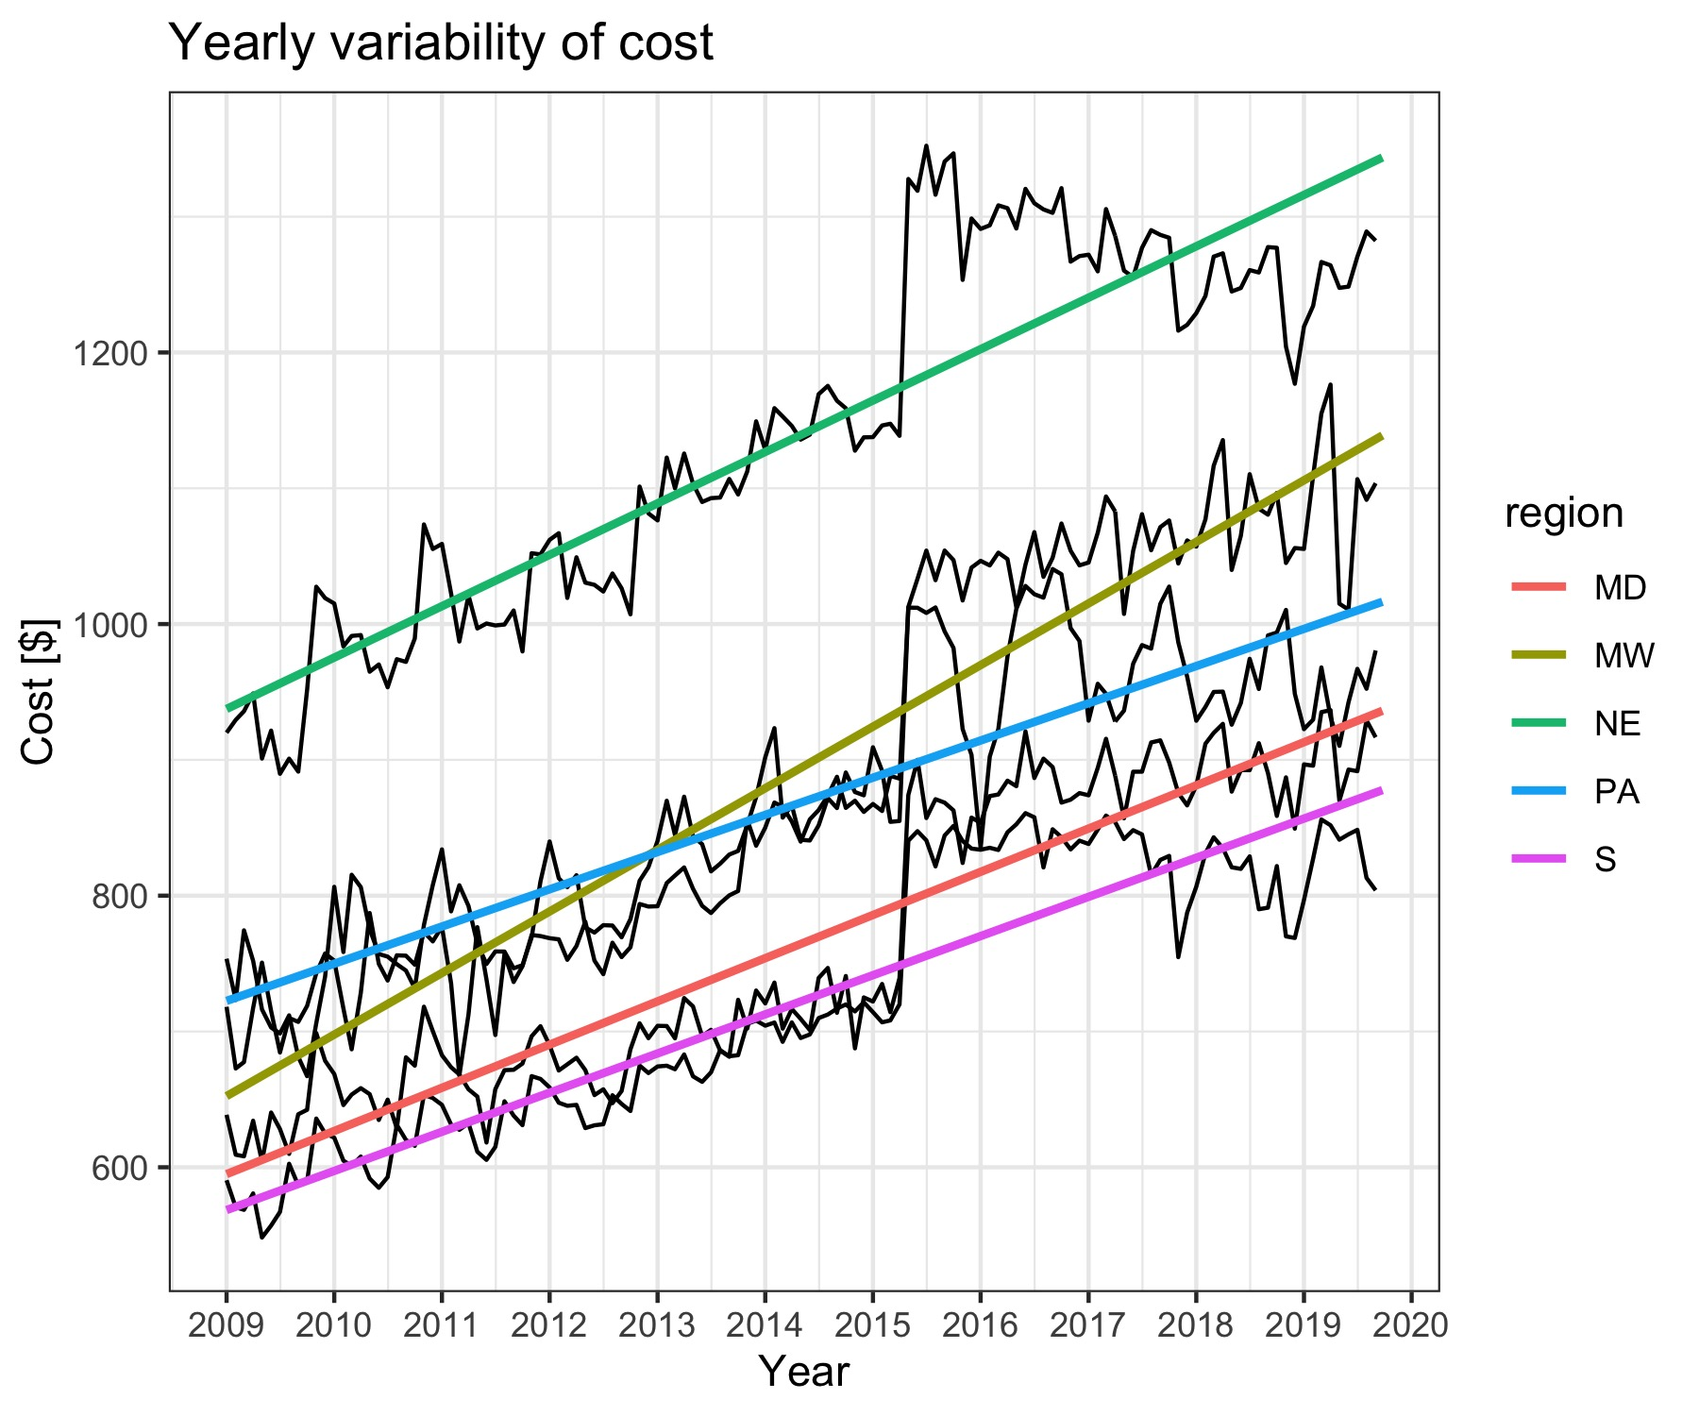
Insurance cost change
All regions show a general increase
Increase in MW is $100 more than in PA

Slide 21
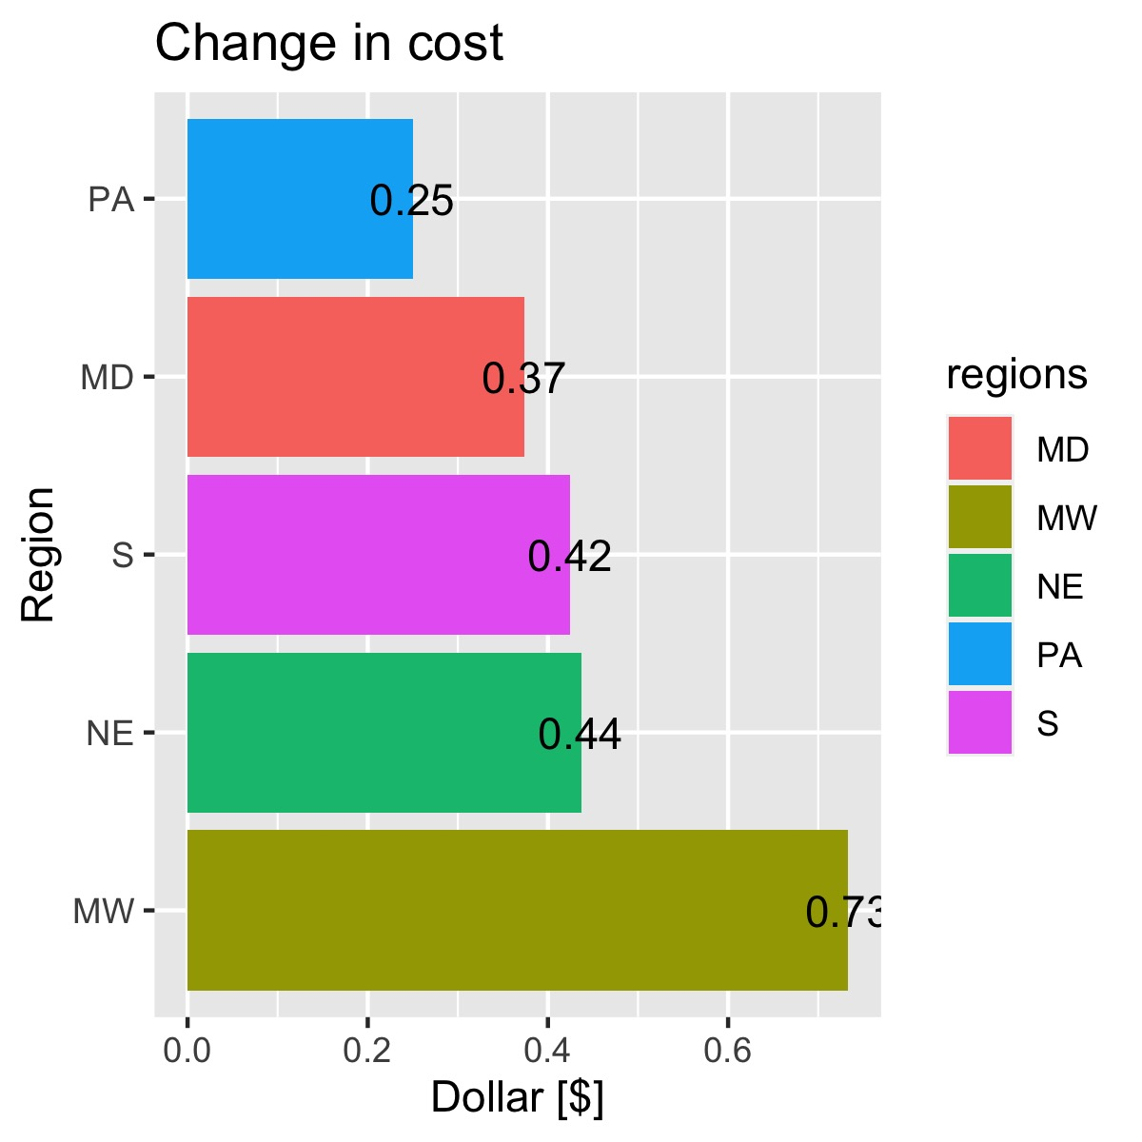
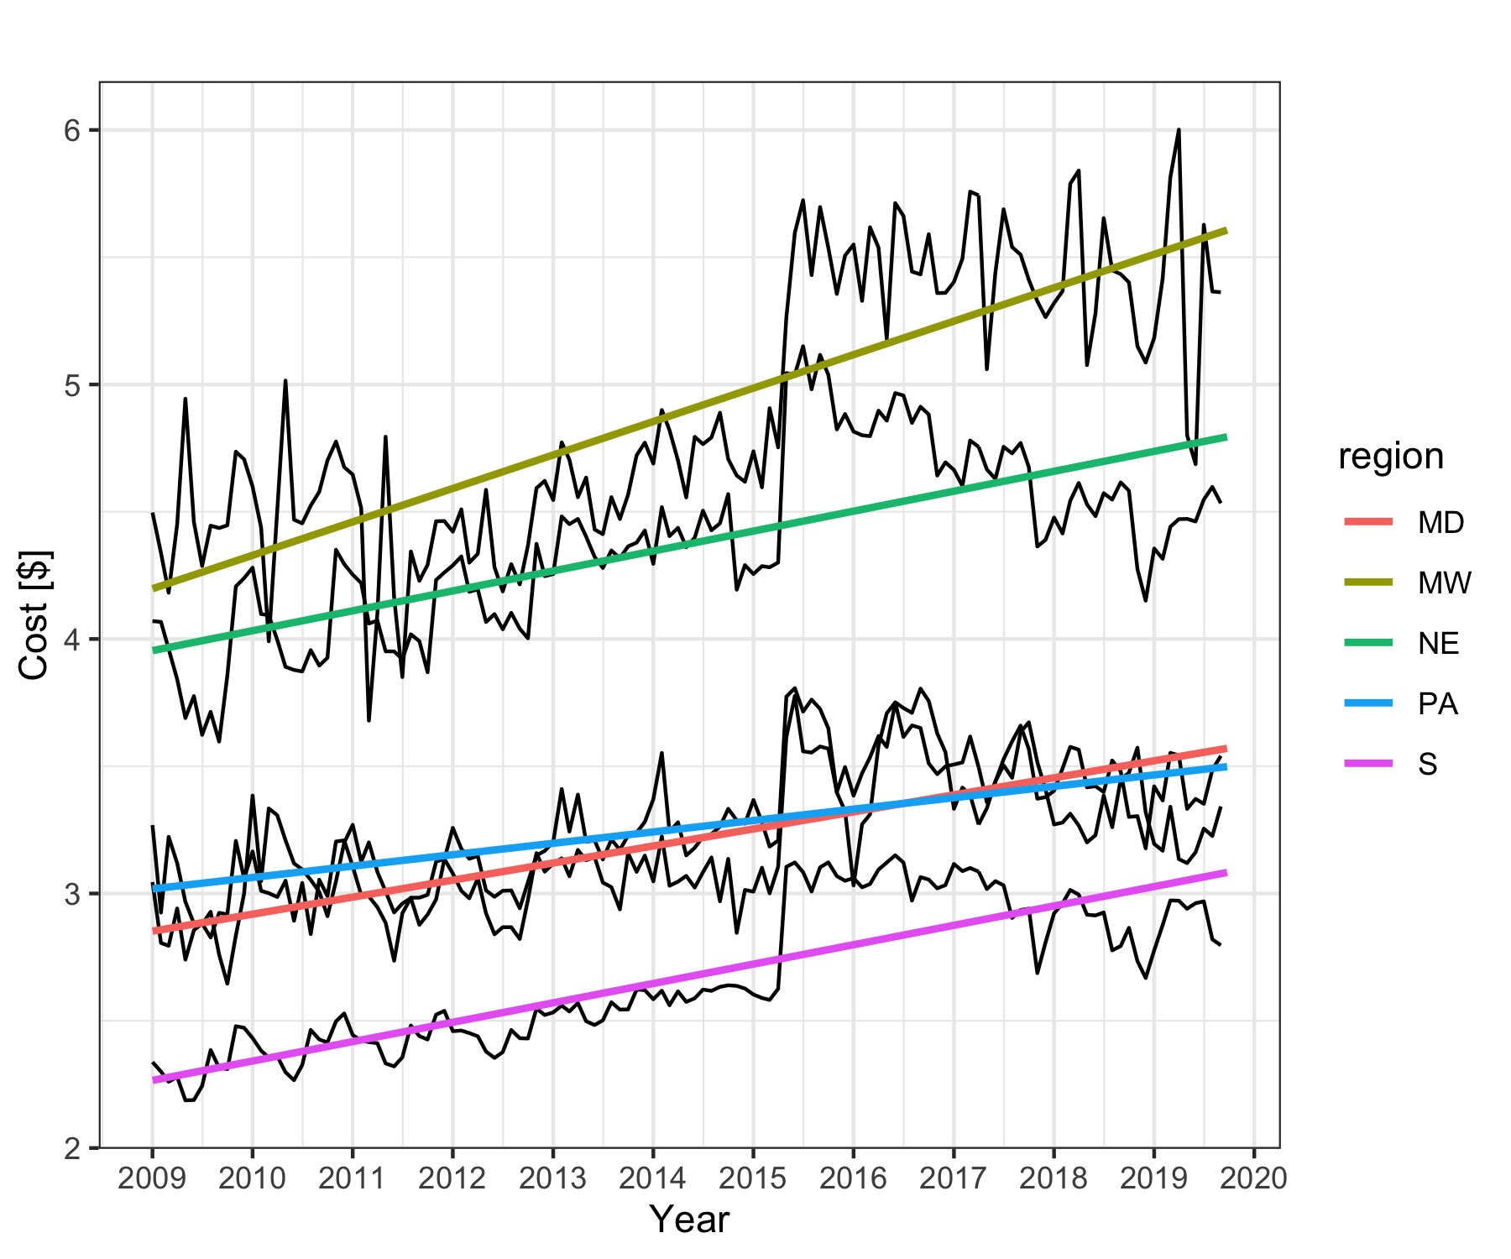
Insurance cost change
All regions show an increase of how much you have to pay per 1000$ insured
Increase in MW is $0.5 more than in PA

Slide 22
Floodzone vs. non-floodzone

Slide 23
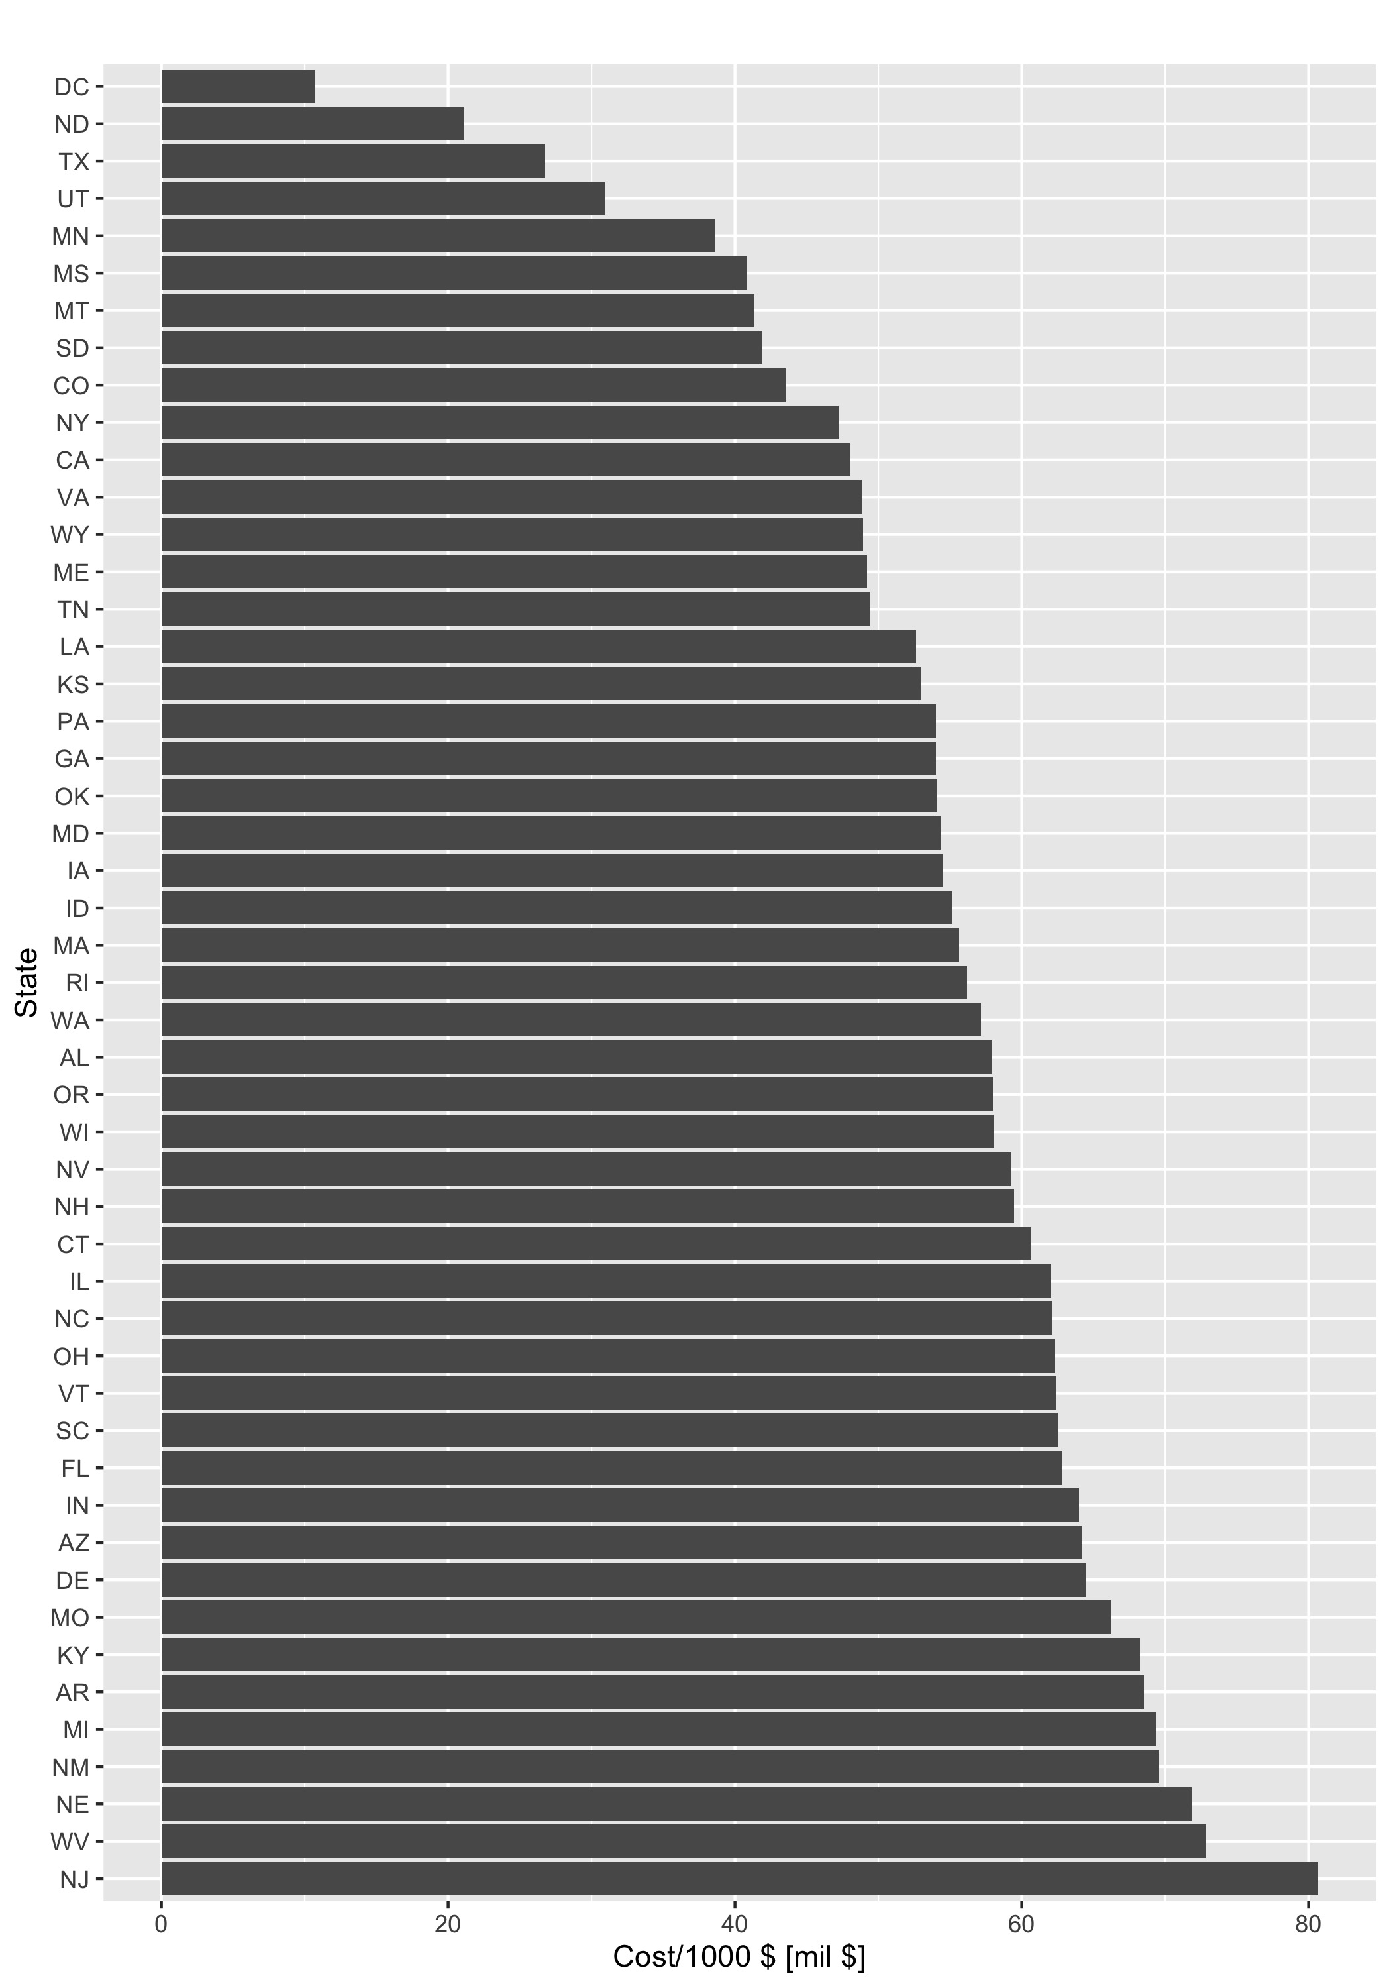
% policies in FloodZone
Clear standout: NJ has by far the largest percentage of coverage in Floodzones
Surprisingly: Texas has a much larger percentage that is NOT in a floodzone

Slide 24
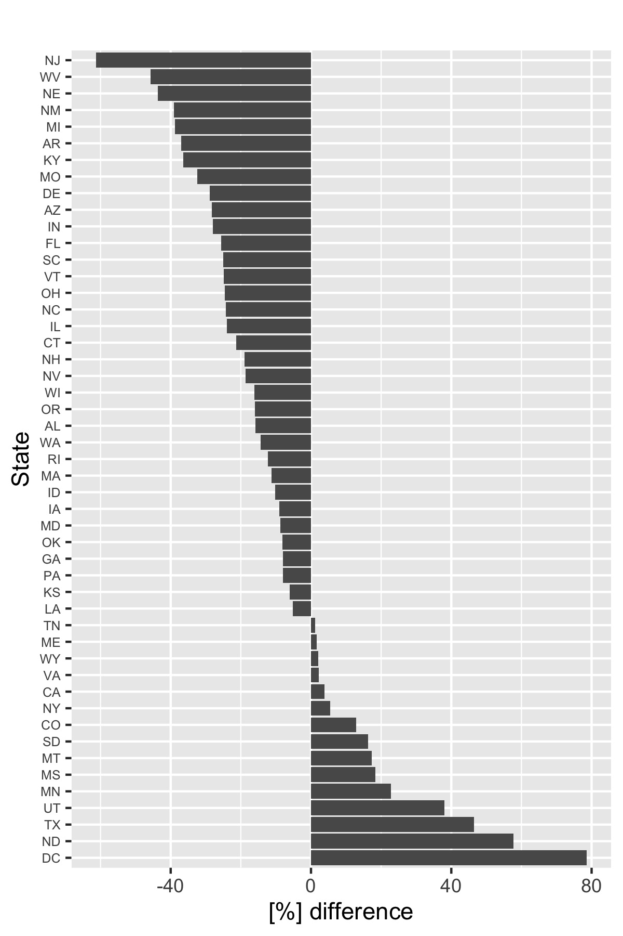
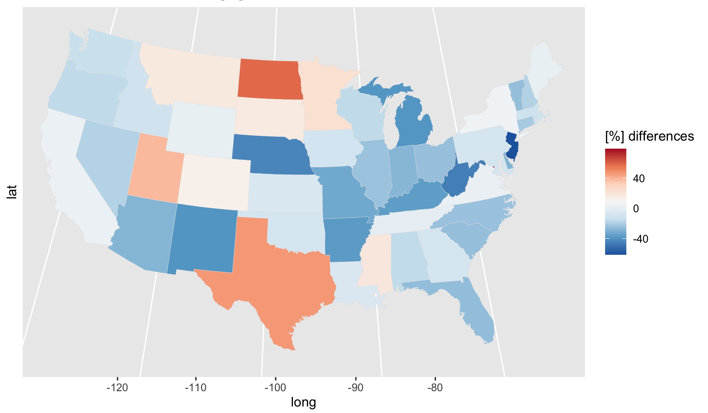
% policies in NOT vs. FloodZone
-ve: more insurances in floodzone
Clear standout: NJ has largest percentage of coverage in Floodzones
Surprisingly: Texas has a larger percentage that is NOT in a floodzone

Slide 25
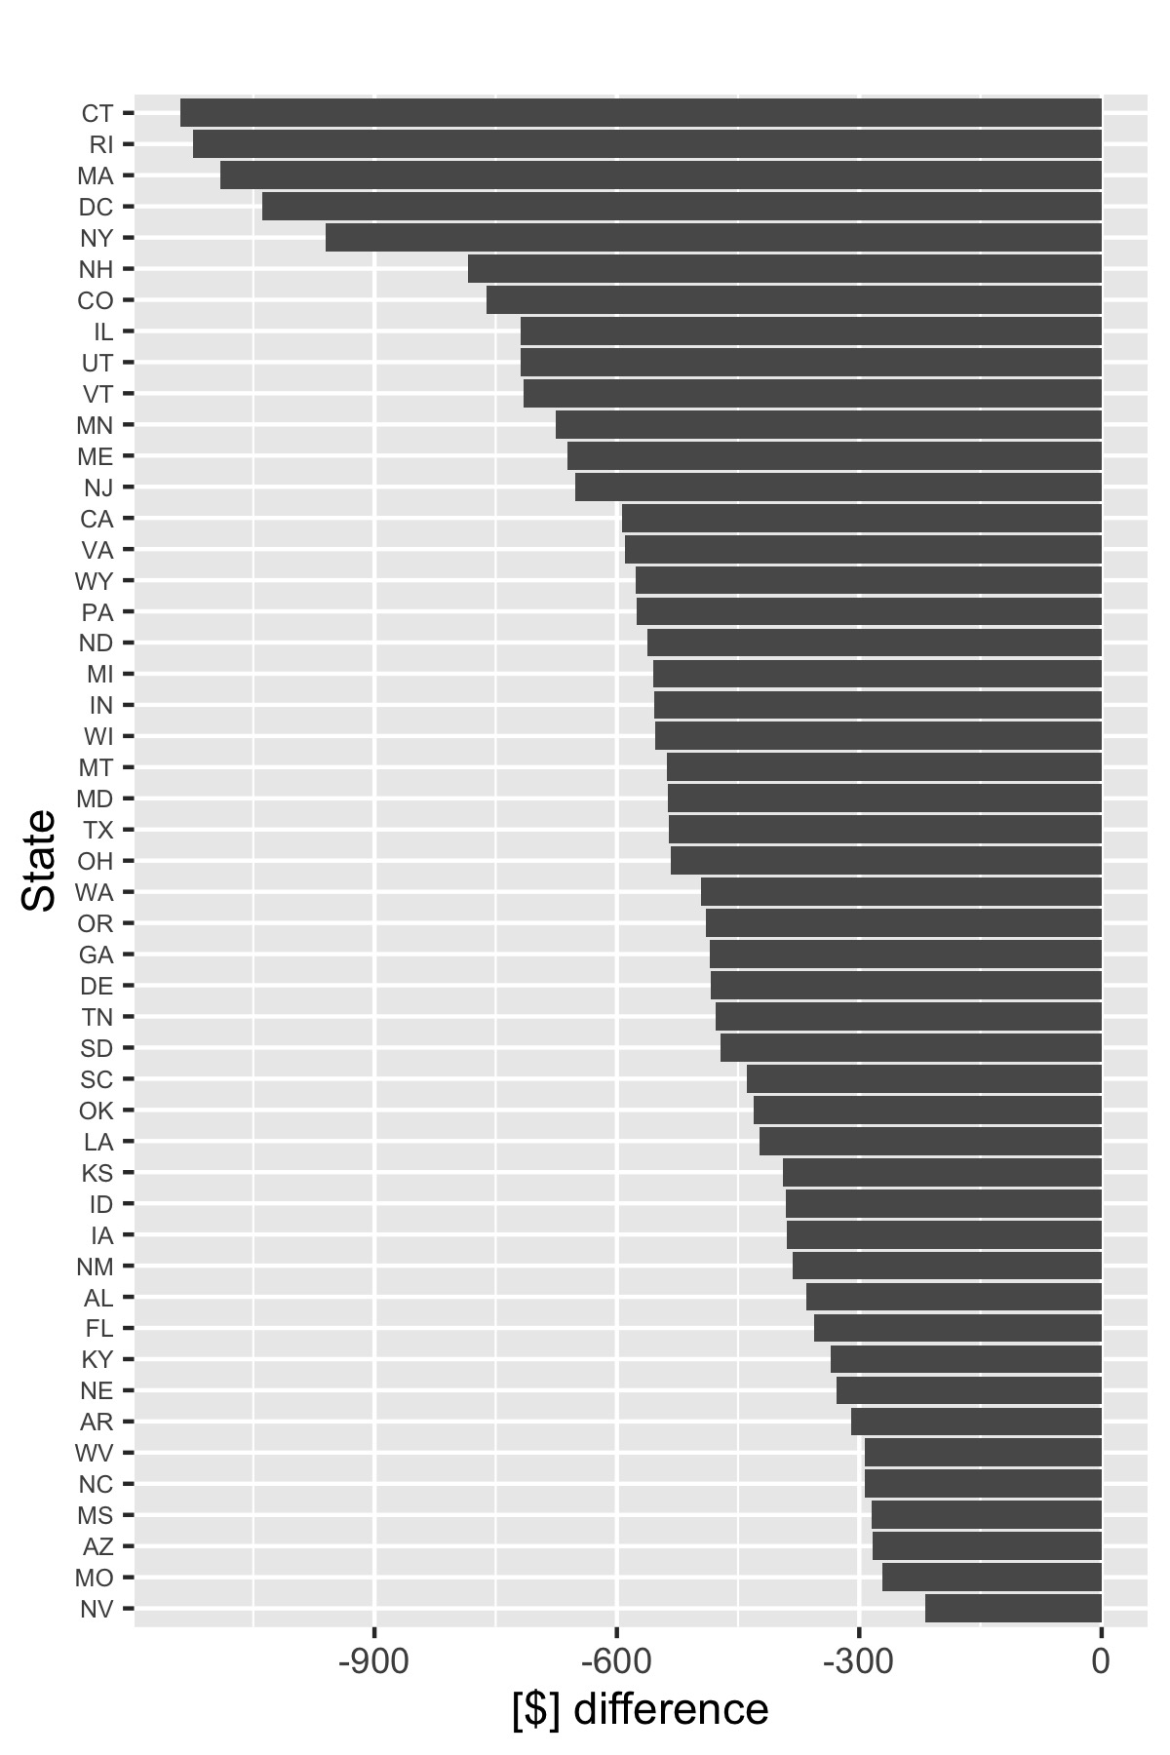
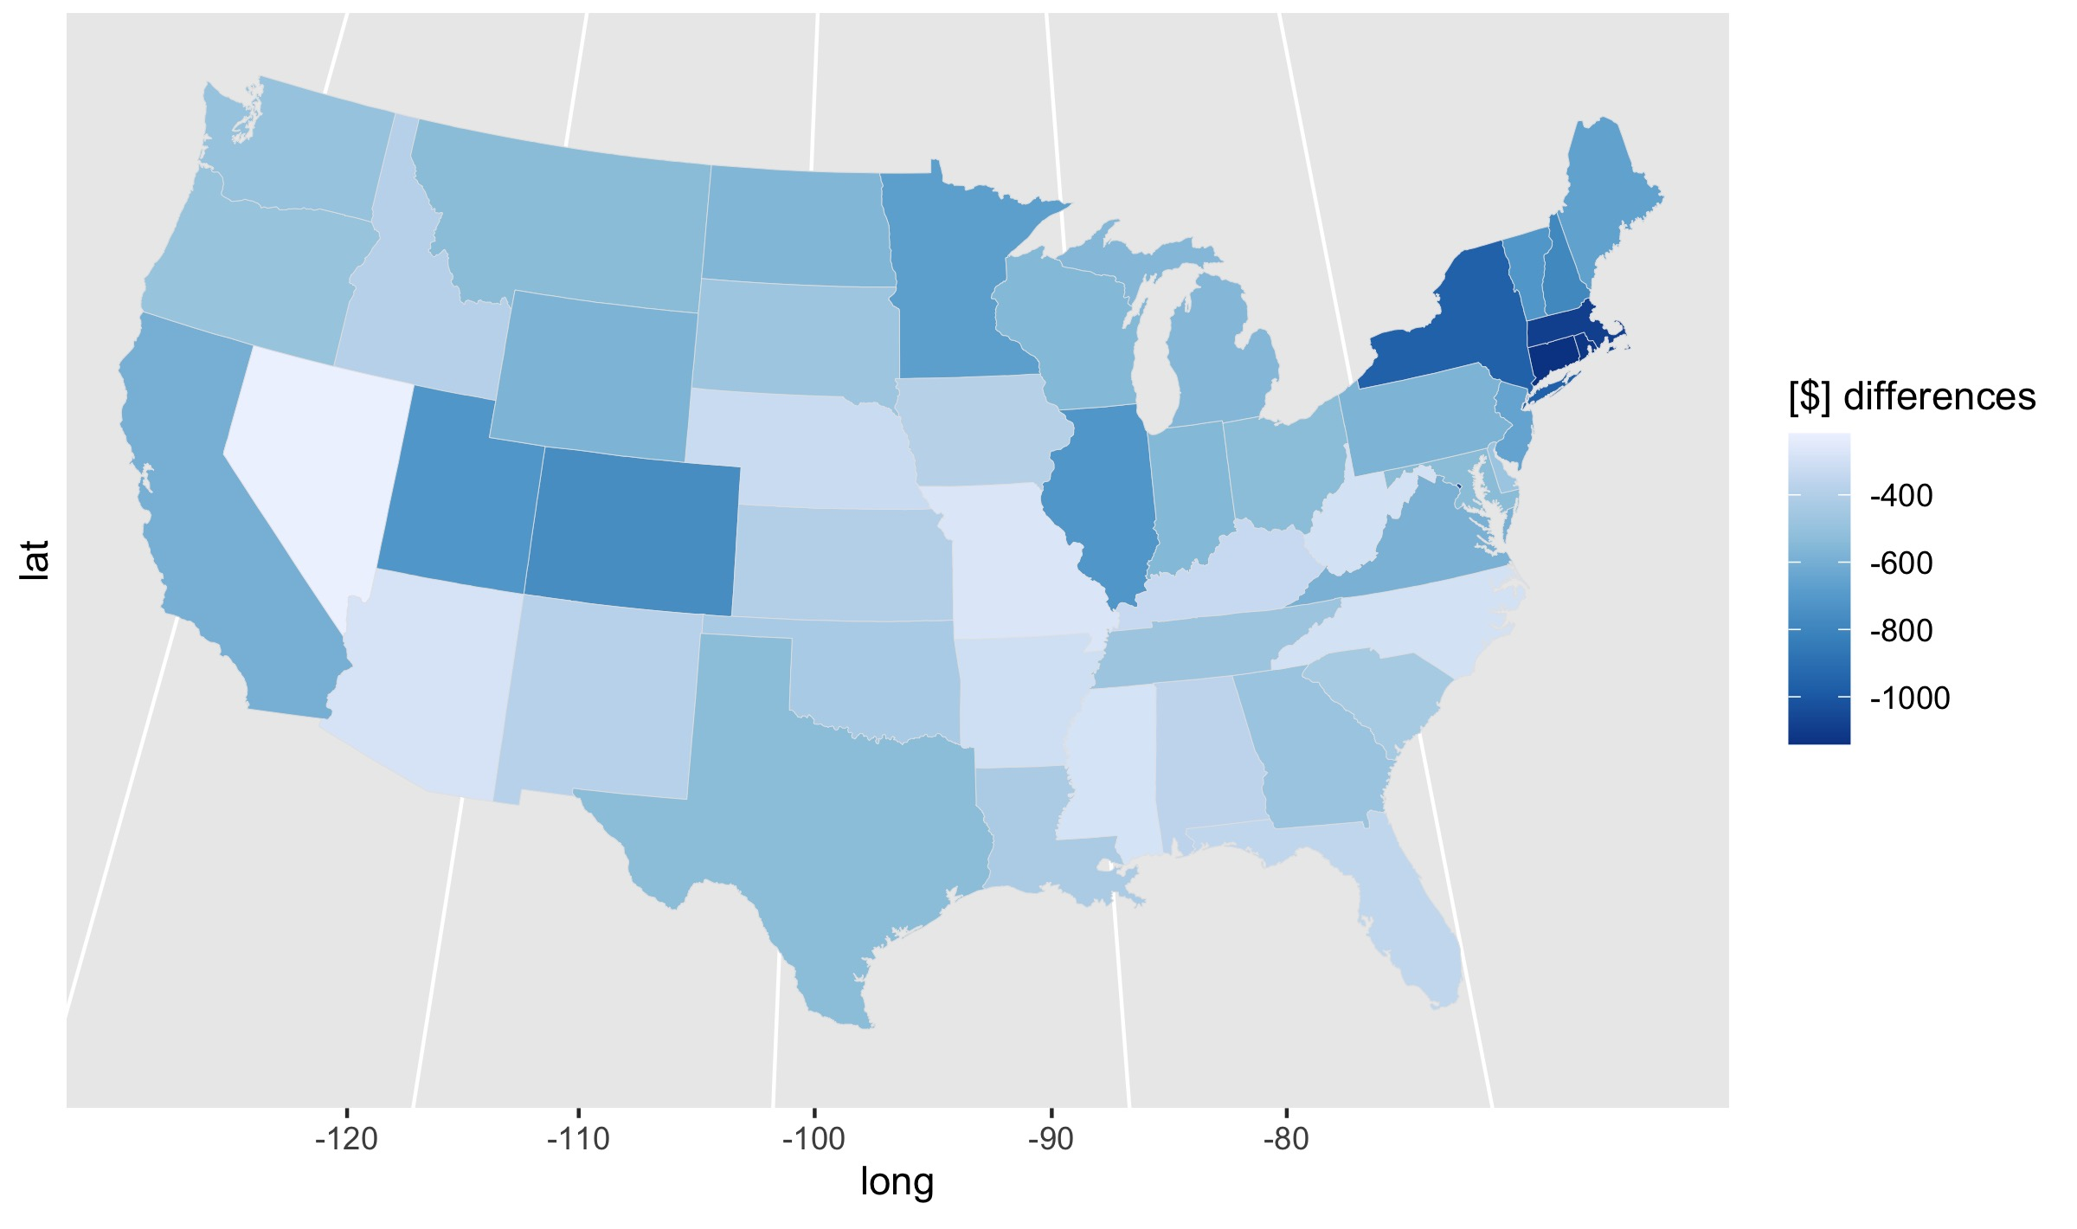
$ Cost difference - NOT vs FloodZone
-ve: more expensive in floodzone
Largest difference: Northeast
Smallest difference: regions with little flooding
BUT also MS

Slide 26
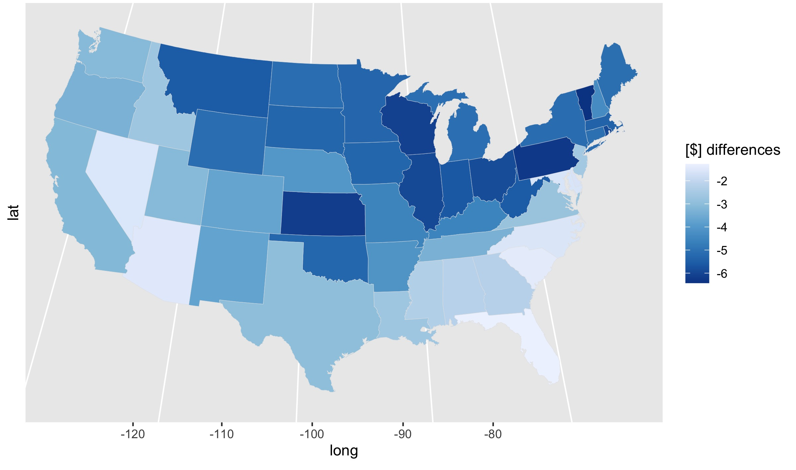
difference $/1000$ -
NOT vs FloodZone
-ve: more expensive in floodzone
Largest difference: Similar pattern to the cost per 1000K where states away from the coast were more expensive per 1000$
Smallest difference: FL, SC

Slide 27
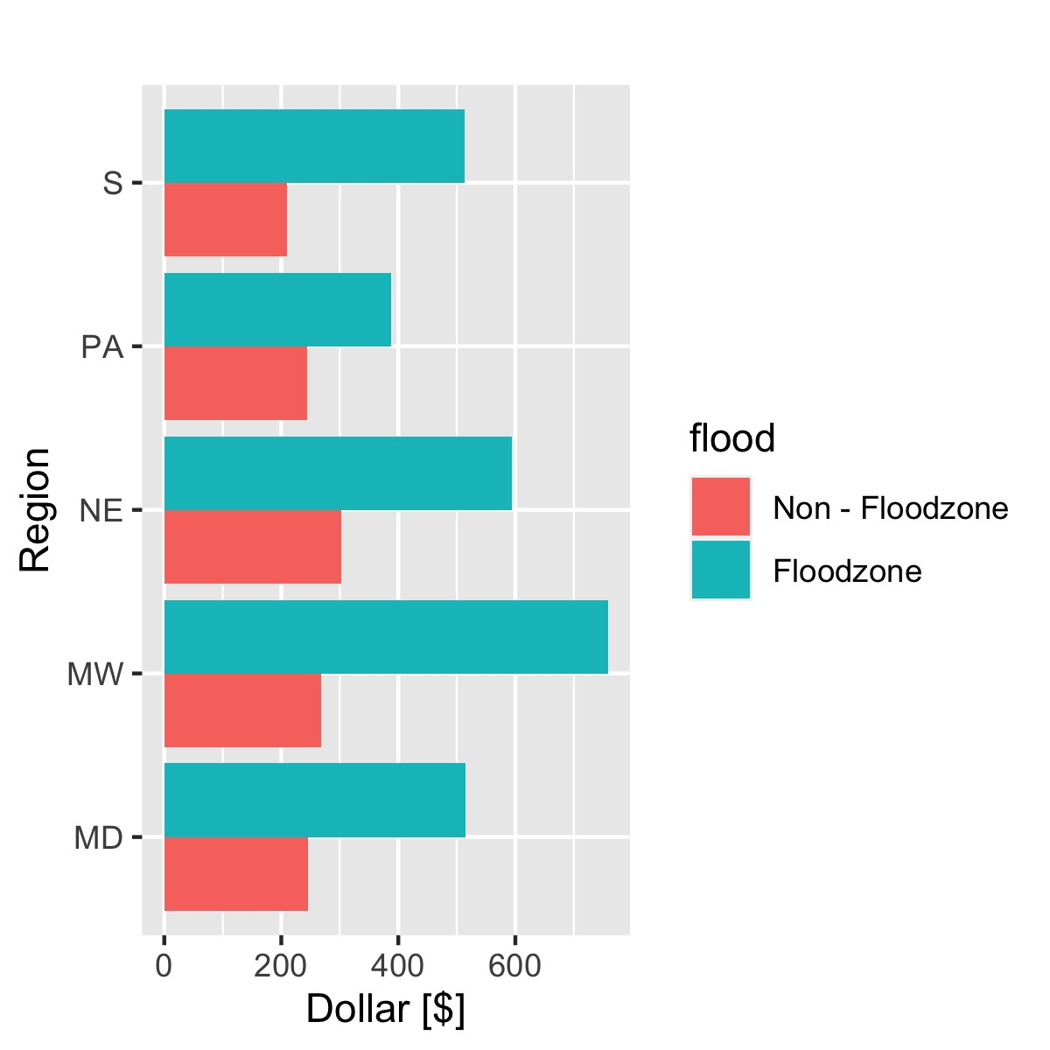
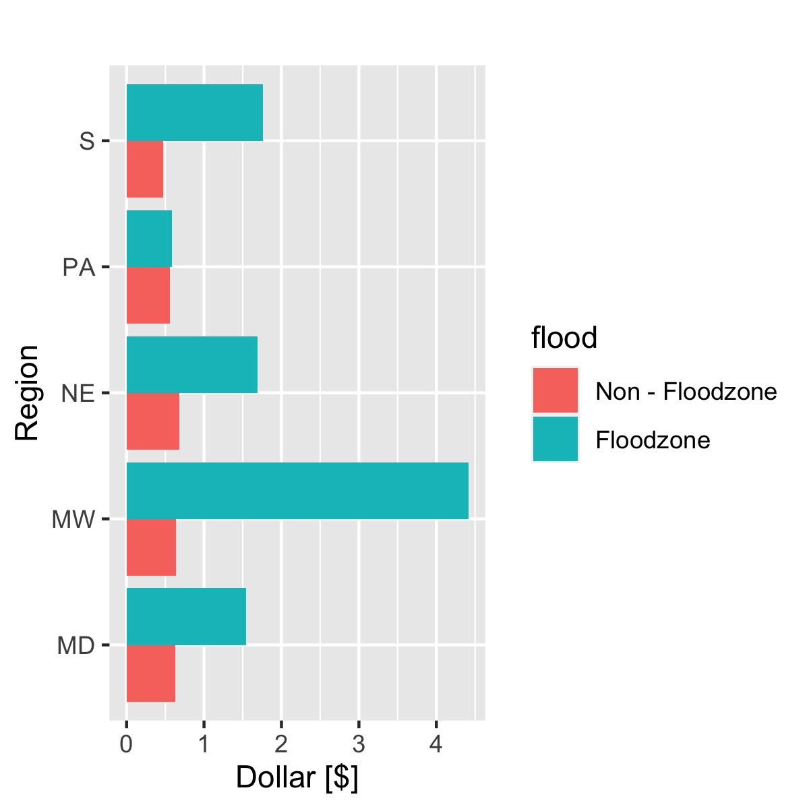
Insurance cost and coverage change
In all regions, the increase in cost and coverage is larger in floodzones vs. non-floodzones
Changes in non-floodzones are similar in all regions.
Changes in floodzones are larges in MW and smallest in PA
Cost increase
Coverage increase

Slide 28
Future Work
Claims data:
Claims per state, per coverage amount, per year, changes etc.
Private insurance:
similarities? Differences?
Links to causes:
Hurricanes, sea-level rise etc.
Links to other sectors:
Housing market?

